Slide 1
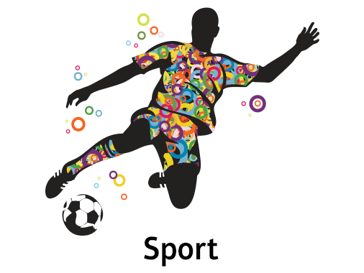
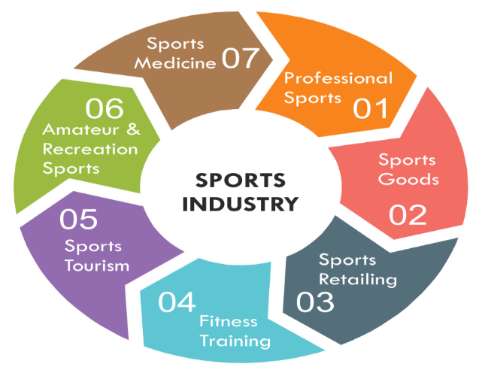
Btec Sport:
Unit 1 & Unit 3

Slide 2


Let’s think….
How many bones can you remember…..
How many muscles can you remember…..
Note down your ideas

Slide 3
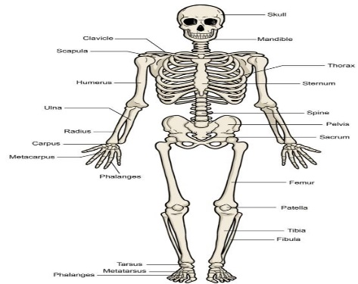
Task 1:
Create a booklet on the structure of the skeletal system.
You need to include:
-Bones
-Types of bones
-Process of bone growth: axial skeleton, appendicular skeleton, spine, curves of the spine, neutral spine alignment, postural deviations (kyphosis, scoliosis).
- Areas of the skeleton: osteoblasts, osteoclasts, epiphyseal plate.

Slide 4

Task 2: RESEARCH TASK
Positive lifestyle factors and their effects on health and well-being
Negative lifestyle factors and their effects on health and well-being
Moe Farah’s training plan and compare Katarina Johnson Thompson training plan
Research the different possible careers and the associated job roles in the sports industry.

