Slide 1


Exam board AQA (7172)
Actions to complete by September:
Bring in 2 lever arch ring binders and a set of file dividers for each one
Complete all 4 of the following tasks:
  TASK 1 : WHAT IS PHILOSOPHY?
  TASK 2 : SHOULD YOU KILL ONE TO SAVE FIVE?
  TASK 3 : KEY TERMINOLOGY
  TASK 4: ARE MORAL FACTS REAL?
Name:

Slide 2
WELCOME
Welcome to A-Level Philosophy. This subject is rigorous, fascinating, and deeply relevant. It helps you ask and examine the fundamental questions of existence, knowledge, truth, and value. By September, you'll already have started thinking like a philosopher.​
​
This pack will prepare you for a confident start in September. All tasks are designed to introduce you to the two Year 12 units:​
- Epistemology (Theory of Knowledge)​
- Moral Philosophy (What makes actions right or wrong?)​
How is the course structured?​
Year 12 | Epistemology | Moral Philosophy
Unit 1 | What is Knowledge? | Normative Ethical Theories
Unit 2 | Perception as a source of knowledge | Applied Ethics
Unit 3 | Reason as a source of knowledge | Meta Ethics
Unit 4 | Limits of knowledge
Year 13 | Metaphysics of Mind | Metaphysics of God
Unit 1 | What do we mean by mind? | The concept and nature of God
Unit 2 | Dualist theories | Arguments related to the existence of God
Unit 3 | Physicalist theories | Religious Language
Unit 4 | Functionalism
Exam overview AQA A-Level Philosophy (7172)
At the end of Year 13 you will be assessed by sitting 2 x 3 hour exams:
Paper 1: Epistemology and Moral Philosophy | Paper 2: Metaphysics of God and Metaphysics of Mind
1 x 3 mark question (AO1) | 1 x 3 mark question (AO1)
2 x 5 mark question (AO1) | 2 x 5 mark question (AO1)
1 x 12 mark question (AO1) | 1 x 12 mark question (AO1)
1 x 25 mark question (AO1 + AO2) | 1 x 25 mark question (AO1 + AO2)

Slide 3
ASSESSMENT OBJECTIVES – WHAT ARE WE LOOKING FOR?
Every piece of work you do in Philosophy will be assessed using these two objectives:
AO1 – Knowledge and Understanding
Demonstrate accurate knowledge of the core concepts and methods of philosophy.
Show your understanding through clear explanation and use of philosophical analysis.
✨ Top tip: Define technical terms clearly (e.g. a priori, substance dualism, moral realism), refer to specific philosophers (e.g. Descartes, Mill, Kant), and explain how their arguments work.
AO2 – Analysis and Evaluation
Analyse philosophical arguments by breaking them down and showing how they work.
Evaluate arguments by assessing their strengths, weaknesses, and implications.
Form and defend your own reasoned judgements.
✨ Top tip: Use phrases like this argument assumes that..., a stronger objection is..., this leads to the conclusion that..., ultimately, the most convincing view is... to show AO2 in action.
AO Skills in Practice
AO Skill | How to Demonstrate It
Knowledge (AO1) | ○ Am I using accurate philosophical terminology? ○ Have I referred to key thinkers, theories, or texts? ○ Am I showing understanding of the topic’s core concepts?
Conceptual Understanding (AO1) | ○ Am I explaining ideas clearly, precisely, and in my own words? ○ Am I using philosophical methods (e.g. conceptual analysis)?
Philosophical Analysis (AO1 & AO2) | ○ Have I broken down arguments into premises and conclusions? ○ Am I showing how arguments work or fail? ○ Am I drawing out implications or assumptions?
Evaluation (AO2) | ○ Have I assessed the strengths and weaknesses of the arguments? ○ Am I considering alternative viewpoints? ○ Am I forming and defending a clear judgement?
Comparison and Critique (AO2) | ○ Have I compared different views effectively? ○ Am I using objections and responses to build depth? ○ Am I explaining why one argument is stronger than another?
Judgement (AO2) | ○ Have I reached a clear conclusion? ○ Is my reasoning logical and well-supported by the analysis above?

Slide 4




ORGANISATION – WHAT TO BRING IN SEPTEMBER
Please bring the following to your first Philosophy lesson:
✅ Two A4 ring binders:
  One for Epistemology and Moral Philosophy
✅ A set of dividers (at least 5 per folder)
✅ A4 lined paper
✅ Pens and highlighters
You’ll be asked to add two more folders in Year 13.
OPTIONAL TEXTBOOKS
It’s strongly recommended that you purchase:
📘 Philosophy for AS and A Level and Philosophy for A Level
Michael Lacewing
(Routledge, 2020)
These are the main course textbooks used throughout both years.
You do not need to bring it to lessons, but it is highly recommended for revision, homework, and independent study.
Copies are widely available online, including second-hand editions on Amazon, eBay, and other textbook resale sites.
Additional Recommended Books
These books are not essential, but many students find them helpful for revising and deepening their understanding. They follow the AQA specification and are structured clearly.
Revision Guides and Additional Support
🟦 My Revision Notes: AQA A-level Philosophy
Dan Cardinal, Jeremy Hayward, Gerald Jones (Hodder Education)
🟪 AQA Philosophy A Level: Year 1 and AS / Year 2 Student Books
Jeremy Hayward and Gerald Jones (Illuminate Publishing)

Slide 5
WHAT TO EXPECT FROM A-LEVEL PHILOSOPHY
Regular Reading and Thinking
Philosophy isn’t just about learning what others have said, it’s about thinking for yourself. You’ll regularly read original philosophical texts and carefully constructed arguments from thinkers like Descartes, Mill, Plato, Kant, and more.
Top tip: Keep a reading journal or ‘thought log’ where you reflect on key ideas and your responses to them.
Note-Taking and Organisation
You’ll be expected to take clear, structured notes that help you understand and remember complex ideas. You’ll organise your folders by topic and keep key definitions, arguments, and objections clearly laid out. Your teacher will guide you in developing a note-taking style that works for you.
Essay Writing
Philosophy is assessed entirely by written exams, so developing confident and clear writing is crucial. You’ll practise:
Planning and structuring essays
Using technical language accurately
Analysing and evaluating arguments
Reaching clear, reasoned judgements
You’ll get regular feedback to help improve your clarity, depth, and logical structure.
Discussion and Debate
Class discussion is a big part of philosophy. You’ll be encouraged to explore questions like What can we know?, What is the mind?, or Is morality objective? with your peers.
You don’t need to be the loudest voice , but you do need to be willing to listen, reflect, and contribute thoughtfully. Being open to challenge (and respectfully challenging others) is key to developing your thinking.
Independent Thinking
Philosophy encourages you to think for yourself. You’ll be weighing up competing arguments, spotting hidden assumptions, and forming your own conclusions , all based on careful reasoning.
You’ll learn to ask deep and difficult questions, and also how to recognise what makes an answer strong, weak, or flawed. Over time, you’ll gain the confidence to defend your own views with clarity and precision.

Slide 6
SUMMER PREPARATION TASKS
These tasks are designed to give everyone a shared foundation in the course.
TASK 1 : WHAT IS PHILOSOPHY?
Read the Philosophy Now Article on pg 7-12 of this booklet.
Highlight the sections of the responses that you think best answer the question 'What is philosophy?'
Write your own short paragraph (200 words) answering the question : What is Philosophy? in the space below.
What is Philosophy?
________________________________________________________________________________________________________________________________________________________________________________________________________________________________________________________________________________________________________________________________________________________________________________________________________________________________________________________________________________________________________________________________________________________________________________________________________________________________________________________________________________________________________________________________________________________________________________________________________________________________________________________________________________________________________________________________________________________________________________________________________________________________________________________________________________________________________________________________________________________________________________________________________________________________________________________________________________________________________________________________________________________________________________________________________________________________________________________________________________________________________________________________________________________________________

Slide 7
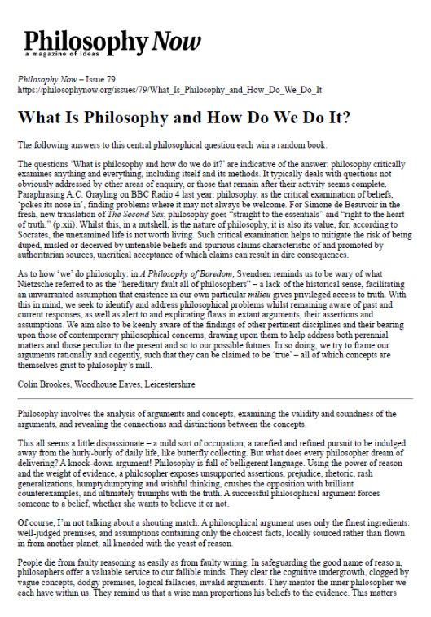

Slide 8
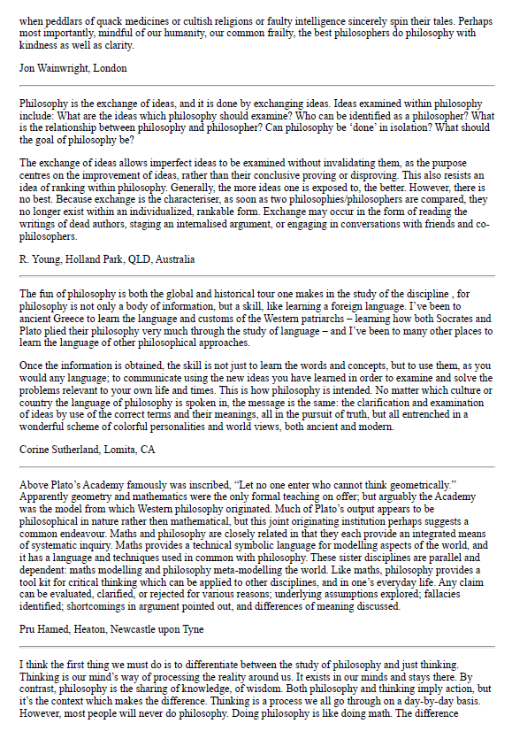

Slide 9
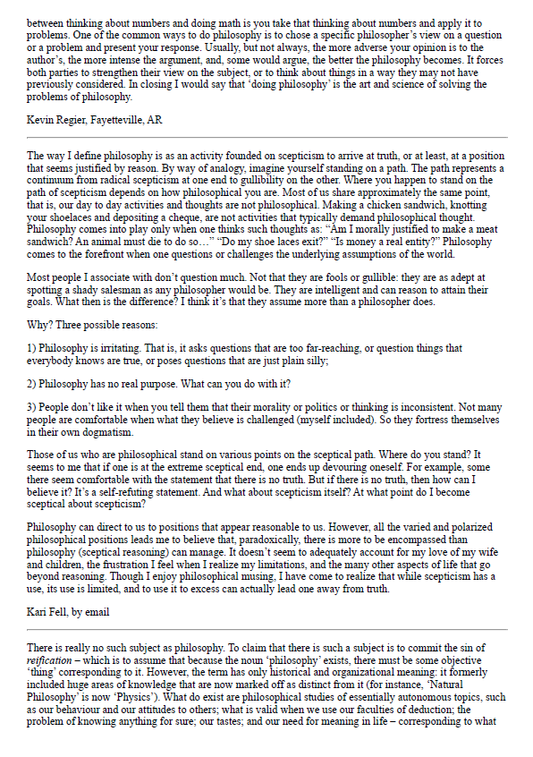

Slide 10
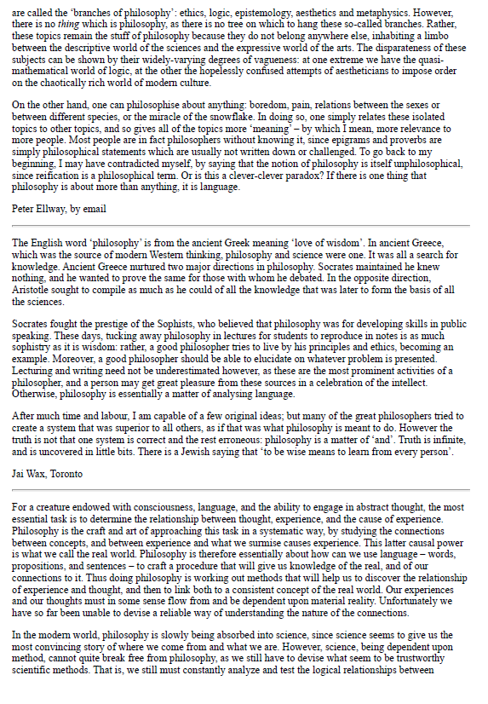

Slide 11
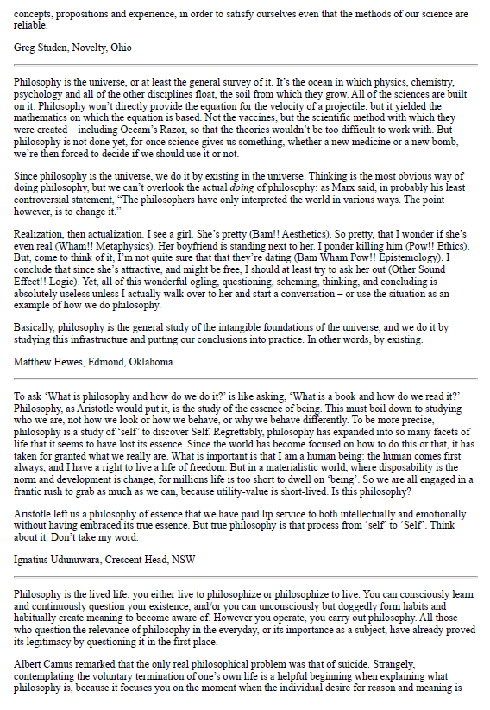

Slide 12
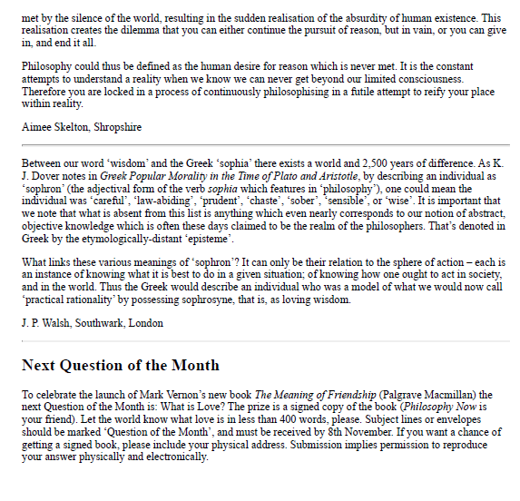

Slide 13
TASK 2 : SHOULD YOU KILL ONE TO SAVE FIVE?
Purpose of the Task:
This activity develops your ability to:
Analyse philosophical arguments
Apply ethical theories to real-life situations
Express your own reasoning clearly and persuasively
It’s also a great introduction to the kind of discussions we’ll have at A-level!
Step 1: Watch
Watch Lecture One of Michael Sandel’s Justice series (Harvard). (Available on YouTube)
🔗 Justice: Episode 1 – The Moral Side of Murder
Step 2: Think
As you watch, take notes on the Trolley Problem and the Fat Man variation. Try to identify:
What decision each case presents
What the class’s different answers were
The moral principles behind those answers
Notes
The Trolley Problem What decision does this case present? Answers given by Sandel's class: Which moral principles can you identify behind the answers given? (e.g. Respecting individual rights) | The Fat Man variation What decision does this case present? Answers given by Sandel's class: Which moral principles can you identify behind the answers given? (e.g. Respecting individual rights)

Slide 14
Step 3: Respond​
Write a short reflection (400 words) in response to this question below:​
Should you kill one person to save five? Explain your answer by referring to the scenarios in the video and at least one philosophical theory.​
Use these prompts to help you:​
What would a utilitarian say?​
What about someone who thinks human rights are inviolable?​
Which view do you find more convincing, and why?​
______________________________________________________________________________________________________________________________________________________________________________________________________________________________________________________________________________________________________________________________________________________________________________________________________________________________________________________________________________________________________________________________________________________________________________________________________________________________________________________________________________________________________________________________________________________________________________________________________________________________________________________________________________________________________________________________________________________________________________________________________________________________________________________________________________________________________________________________________________________________________________________________________________________________________________________________________________________________________________________________________________________________________________________________________________________________________________________________________________________________________________________________________________________________________________________

Slide 15
TASK 3 : KEY TERMINOLOGY
Instructions:
Create a set of flashcards — one for each of the 10 key terms shown below.
On each flashcard:
  Front: Write the term (e.g. A Priori Knowledge)
  Back: Write the definition and an example where appropriate
Use your flashcards to test yourself repeatedly over the summer.
You should keep going until you can:
  Define each term accurately and give a clear example of each one
  Spot the difference between similar terms (e.g. necessary vs contingent, or a priori vs a posteriori)
You will be tested on these terms in the first week of the course, so make sure you know them securely.
​
A PRIORI KNOWLEDGE Propositional knowledge not acquired from/not justified by experience. e.g. "2+2 =4" | A POSTERIORI KNOWLEDGE Propositional knowledge acquired from/justified by experience. e.g. "Grass is green"
SYNTHETIC TRUTH A proposition whose truth depends upon how reality is in addition to the meanings of its constituent concepts. e.g. "Water boils at 100 °C" | ANALYTIC TRUTH A proposition whose truth depends only upon the meanings of its constituent terms/concepts. e.g. "vixens are female foxes"
NECESSARY TRUTH A proposition that is true in all possible worlds (i.e. it could not have been false) "A triangle has 3 sides" | CONTINGENT TRUTH A proposition that is true in the actual world but false in at least one possible world (i.e. it could have been false). "Donald Trump is President of the USA"
MORAL REALISM The view that there are mind-independent/objective moral properties/facts. E.g. If it a society approves of torture, it is still morally wrong because moral facts exist independently of human opinion | UTILITARIANISM Utilitarianism An action is morally right if and only if [we can reasonably expect/predict that] it maximises utility.
DEONTOLOGICAL ETHICS Ethical theories that are based on the existence of duties/rights. They focus on acts/motives conforming to particular rules | MORAL ANTI-REALISM The view that either (a) there are no moral properties/facts at all or (b) there are moral properties/facts but they are all mind-dependent

Slide 16
TASK 4: ARE MORAL FACTS REAL?
Context and Background Note: *Never Let Me Go*
In Never Let Me Go, a group of children are raised at a boarding school called Hailsham in the English countryside. On the surface, their lives seem normal, they have lessons, friendships, teachers (“guardians”), and art classes. But gradually, we learn that they are not ordinary children.
The students at Hailsham are clones, created for the sole purpose of donating their vital organs to others. When they reach adulthood, they begin a process of giving donations until they die. They are not allowed to choose their futures, fall in love freely, or have children.
In Chapter 7, one of the guardians, Miss Lucy, breaks the usual silence around the students’ future. She tells them, more directly than ever before, what lies ahead. The chapter captures the tension between what the students have always sensed and what has been deliberately kept vague.
As you read, think about:
- Is it morally right to create and use people in this way, even if it helps others?
- Do these students have the same value and rights as anyone else?
- How does it feel to be “told and not told” the truth about your own life?
Your Task
Read Chapter 7 of *Never Let Me Go* by Kazuo Ishiguro (provided in your booklet).
Then complete the following:
1. In your own words, summarise what Miss Lucy reveals to the students. How do they react?
2. Do you think it is morally acceptable to create human beings just to harvest their organs? Why or why not?
3. Use your knowledge of moral philosophy to identify whether the views in this chapter are more in line with:
- Moral realism (the idea that there are objective moral truths)
- Moral anti-realism (the idea that morality is based on subjective or cultural attitudes)
Explain your reasoning clearly.
Optional: Watch the film version of *Never Let Me Go* (2010) and compare how the film presents the same moral ideas.
Available to rent on Amazon Prime Video, Apple TV or YouTube.

Slide 17
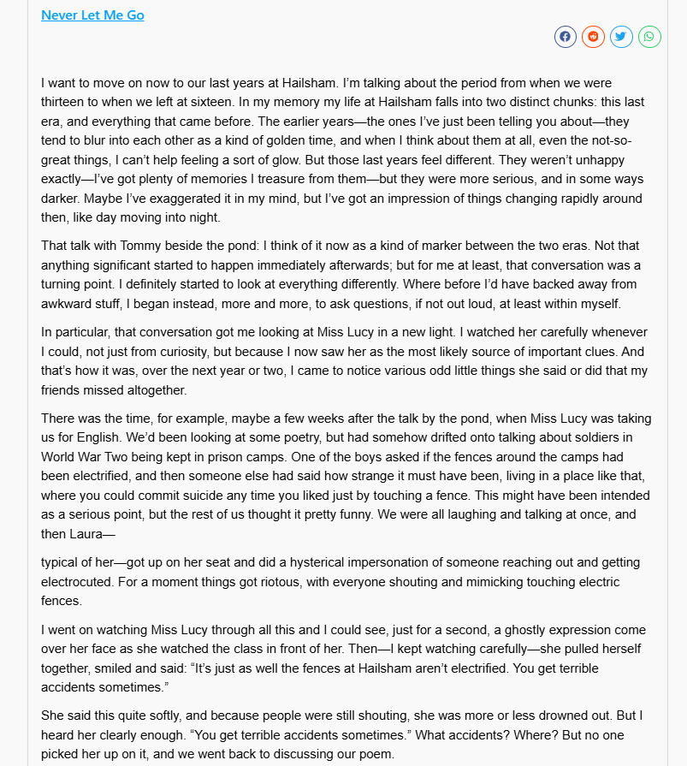

Slide 18
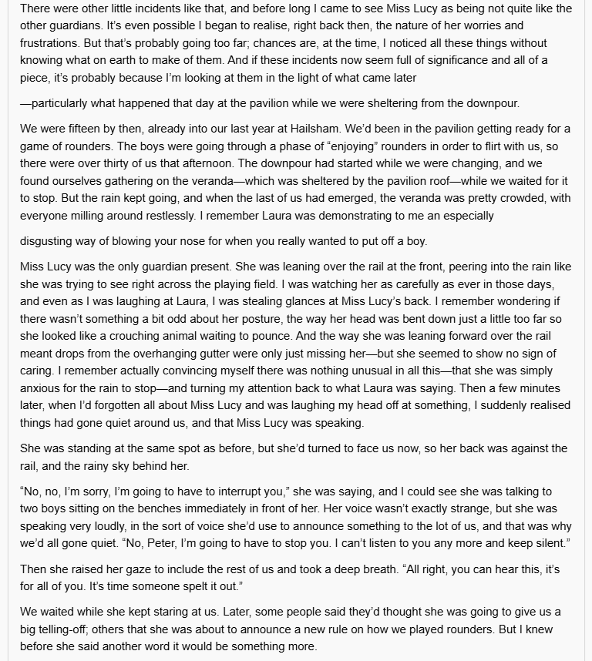

Slide 19
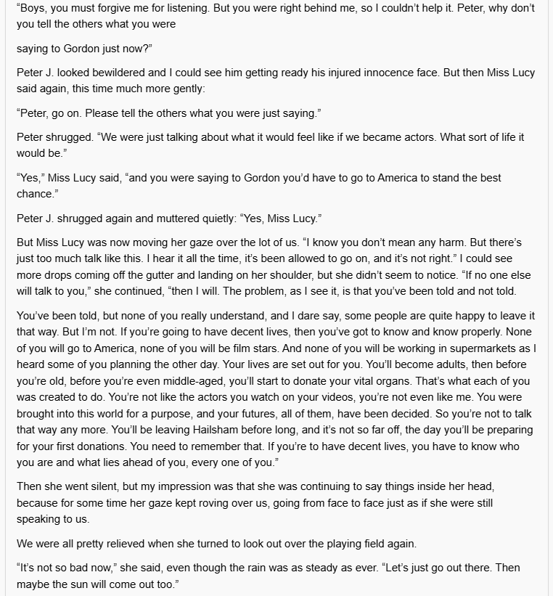

Slide 20
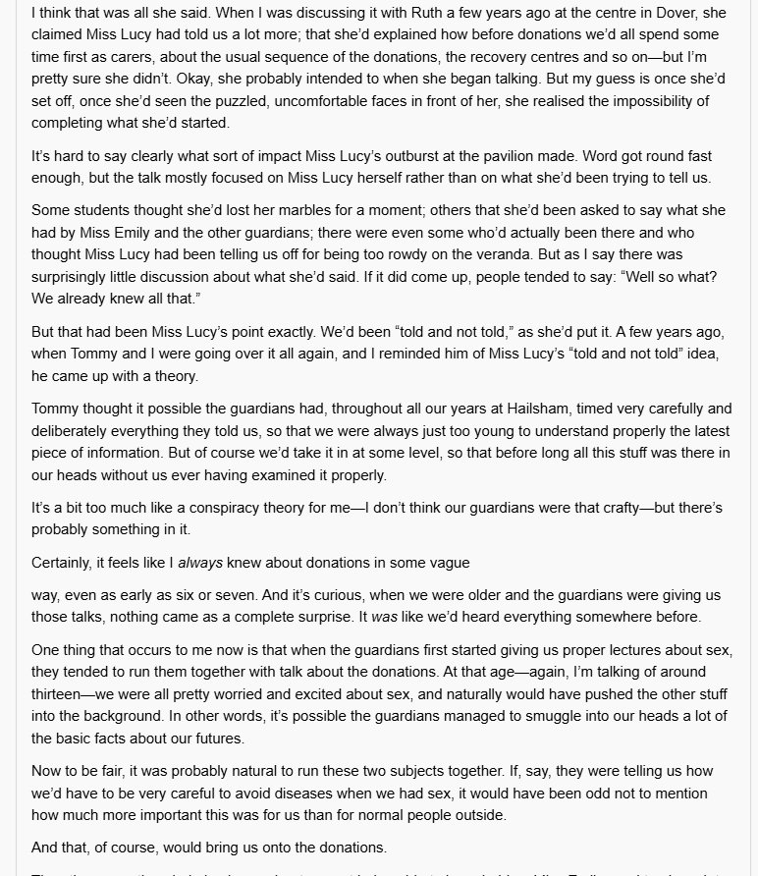

Slide 21
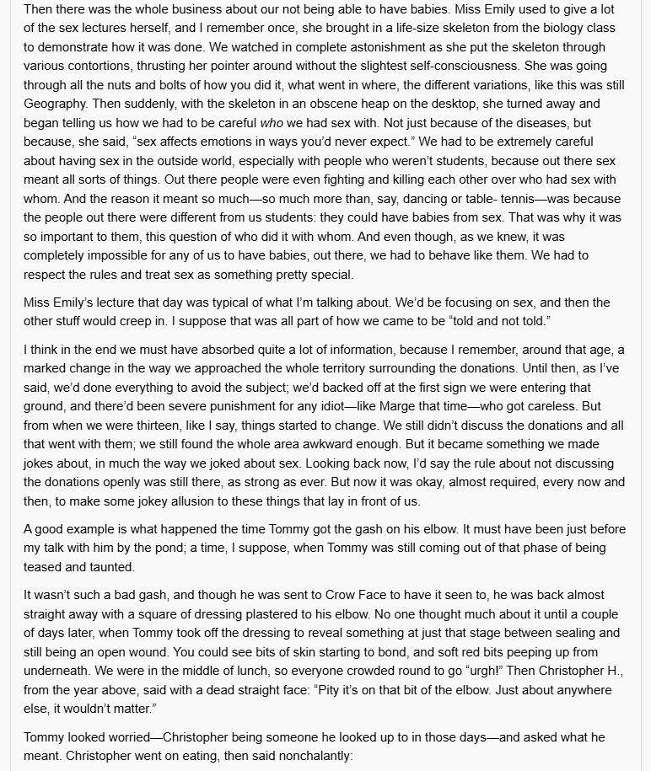

Slide 22
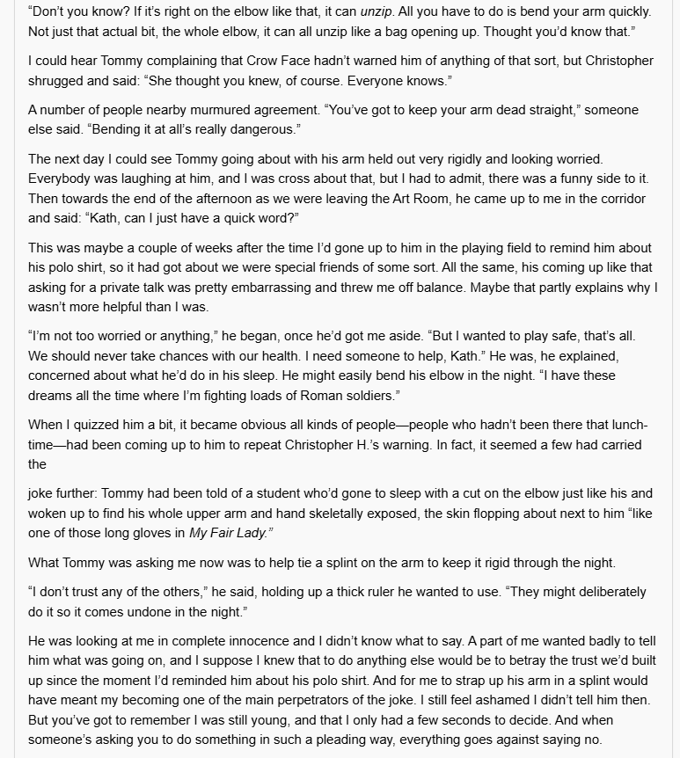

Slide 23
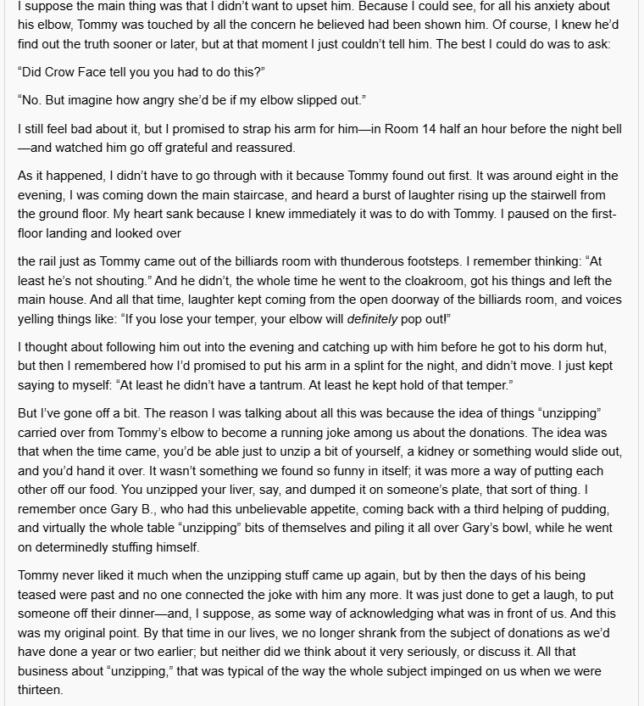

Slide 24
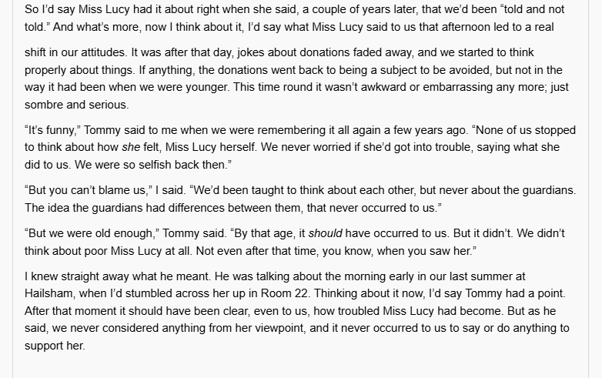
NOW COMPLETE THE TASKS BELOW ON THE FOLLOWING PAGES
1. In your own words, summarise what Miss Lucy reveals to the students. How do they react?​
2. Do you think it is morally acceptable to create human beings just to harvest their organs? Why or why not?​
3. Use your knowledge of moral philosophy to identify whether the views in this chapter are more in line with:​
- Moral realism (the idea that there are objective moral truths)​
- Moral anti-realism (the idea that morality is based on subjective or cultural attitudes)​
Explain your reasoning clearly.​
​
Optional: Watch the film version of *Never Let Me Go* (2010) and compare how the film presents the same moral ideas.​
Available to rent on Amazon Prime Video, Apple TV or YouTube.​

Slide 25
______________________________________________________________________________________________________________________________________________________________________________________________________________________________________________________________________________________________________________________________________________________________________________________________________________________________________________________________________________________________________________________________________________________________________________________________________________________________________________________________________________________________________________________________________________________________________________________________________________________________________________________________________________________________________________________________________________________________________________________________________________________________________________________________________________________________________________________________________________________________________________________________________________________________________________________________________________________________________________________________________________________________________________________________________________________________________________________________________________________________________________________________________________________________________________________________________________________________________________________

Slide 26
______________________________________________________________________________________________________________________________________________________________________________________________________________________________________________________________________________________________________________________________________________________________________________________________________________________________________________________________________________________________________________________________________________________________________________________________________________________________________________________________________________________________________________________________________________________________________________________________________________________________________________________________________________________________________________________________________________________________________________________________________________________________________________________________________________________________________________________________________________________________________________________________________________________________________________________________________________________________________________________________________________________________________________________________________________________________________________________________________________________________________________________________________________________________________________________________________________________________________________________

Slide 27
______________________________________________________________________________________________________________________________________________________________________________________________________________________________________________________________________________________________________________________________________________________________________________________________________________________________________________________________________________________________________________________________________________________________________________________________________________________________________________________________________________________________________________________________________________________________________________________________________________________________________________________________________________________________________________________________________________________________________________________________________________________________________________________________________________________________________________________________________________________________________________________________________________________________________________________________________________________________________________________________________________________________________________________________________________________________________________________________________________________________________________________________________________________________________________________________________________________________________________________

Slide 28
______________________________________________________________________________________________________________________________________________________________________________________________________________________________________________________________________________________________________________________________________________________________________________________________________________________________________________________________________________________________________________________________________________________________________________________________________________________________________________________________________________________________________________________________________________________________________________________________________________________________________________________________________________________________________________________________________________________________________________________________________________________________________________________________________________________________________________________________________________________________________________________________________________________________________________________________________________________________________________________________________________________________________________________________________________________________________________________________________________________________________________________________________________________________________________________________________________________________________________________

