Slide 1

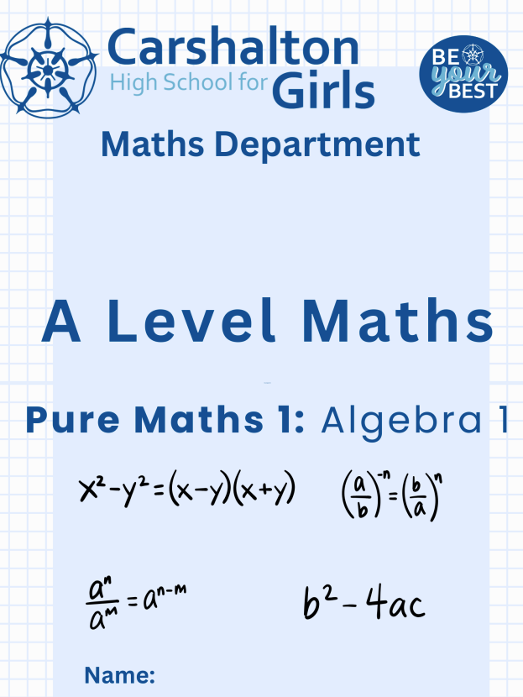
Year 12 A Level Maths Induction
July 2026

Slide 2


Find out more here: What next after AS/A level Mathematics? | AMSP

Slide 3
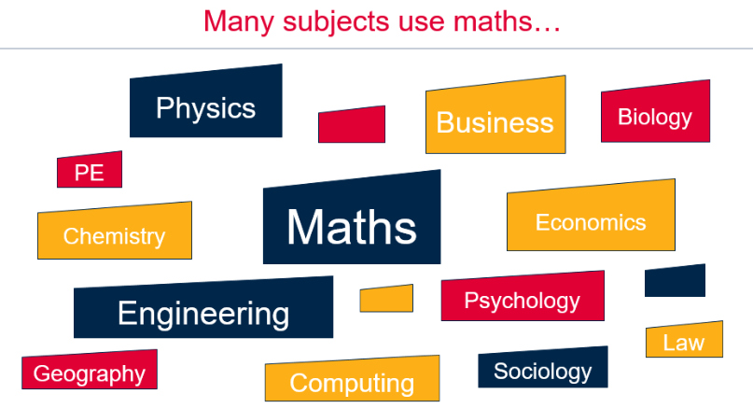

Slide 4
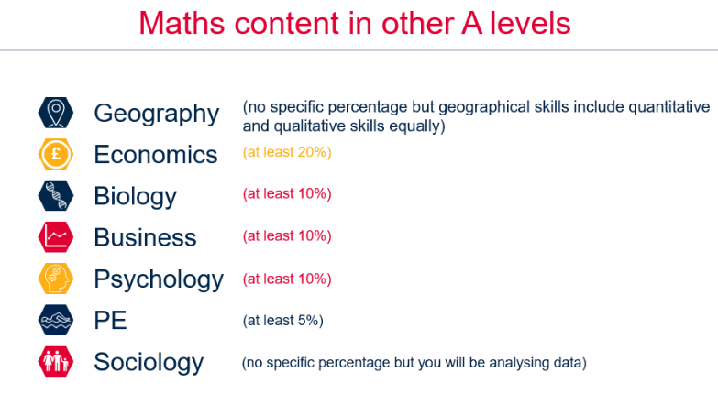

Slide 5
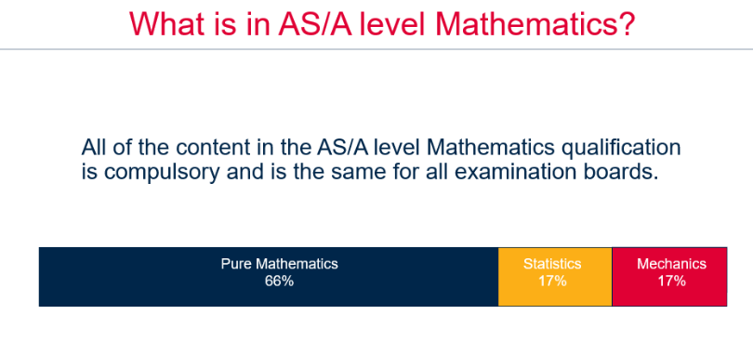

Slide 6
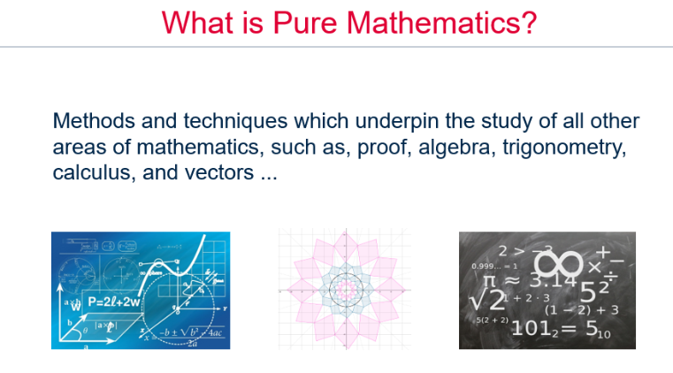
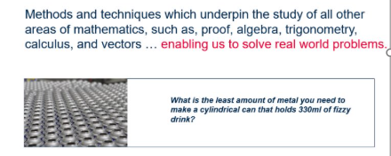

Slide 7
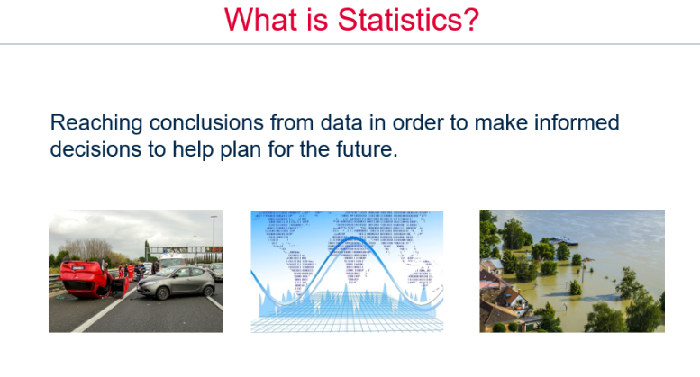
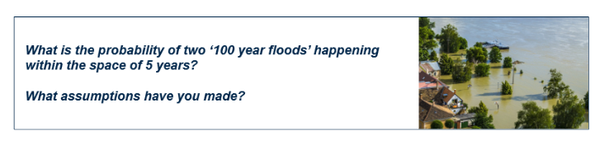

Slide 8
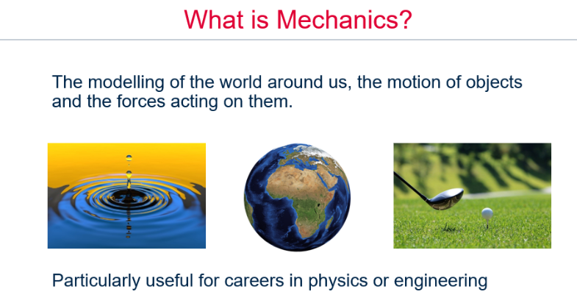
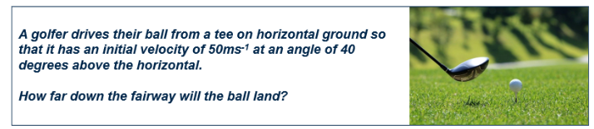

Slide 9
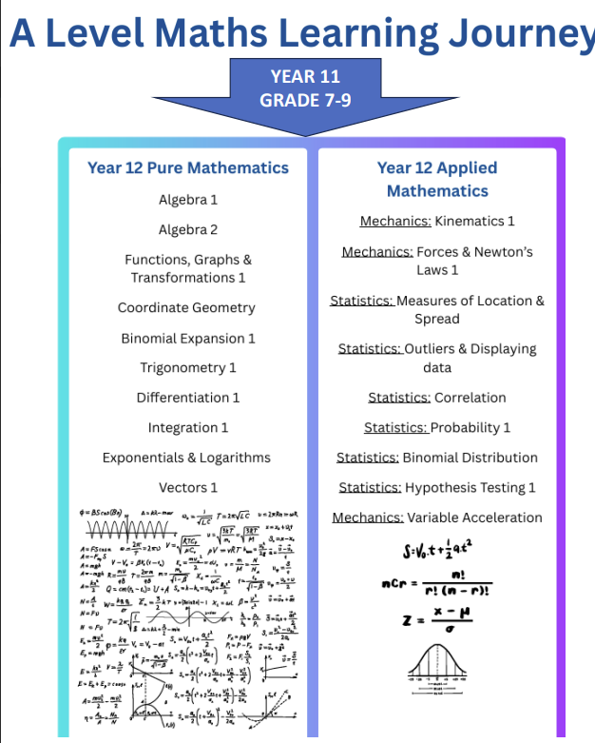
What will you learn?
A Level Maths is a demanding but satisfying course. You will cover 19 units in your first year alone….

Slide 10
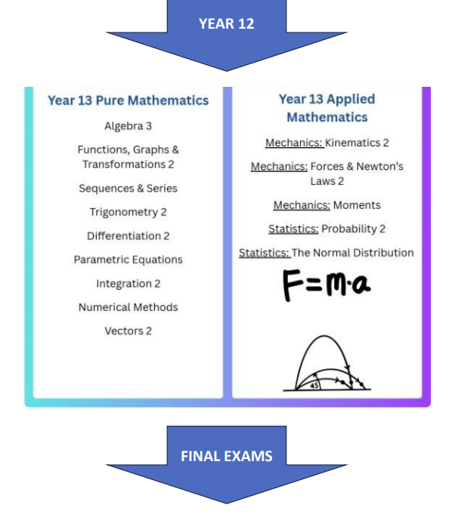
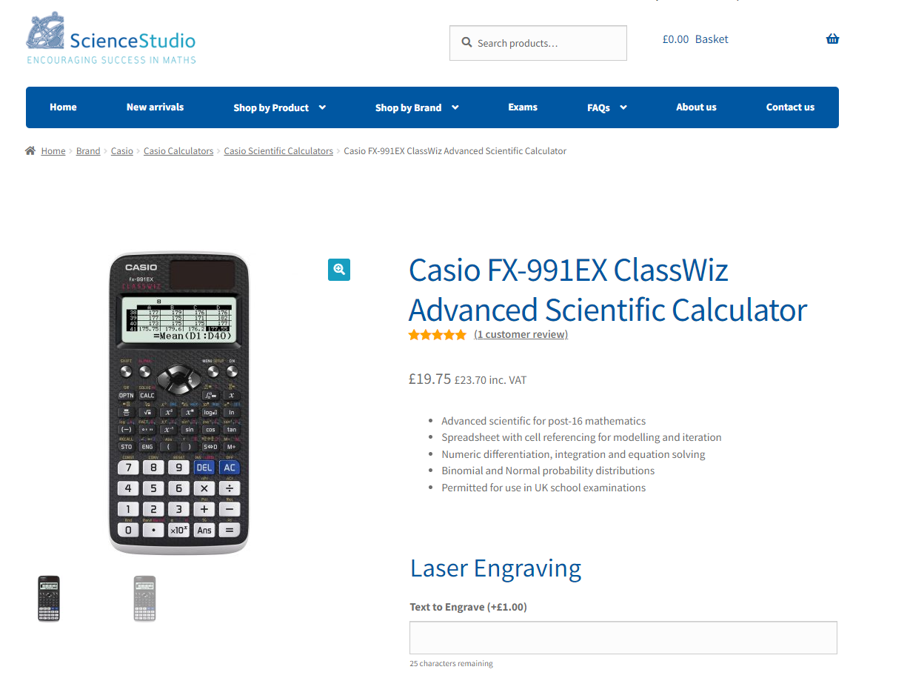
Over 2 years you will have covered 33 units !
You will need to have a lever arch ring binder in which to store your workbooks.
You will also need a ClassWiz calculator 991 model
Click here for more information: Casio FX-991EX ClassWiz Advanced Scientific Calculator (sciencestudio.co.uk)

Slide 11
We will provide you with an exercise book for your additional notes/extra work and revision
We provide support in organising your work
You will have access to an online textbook
We use OCR as our exam board, however we use a lot of Edexcel materials for learning, and OCR materials for assessment
You will usually have 2 teachers, one for Pure and one for Applied Maths
You will have 9 lessons a fortnight
You will need to complete the Bridging Work in order to get off to the best possible start

Slide 12
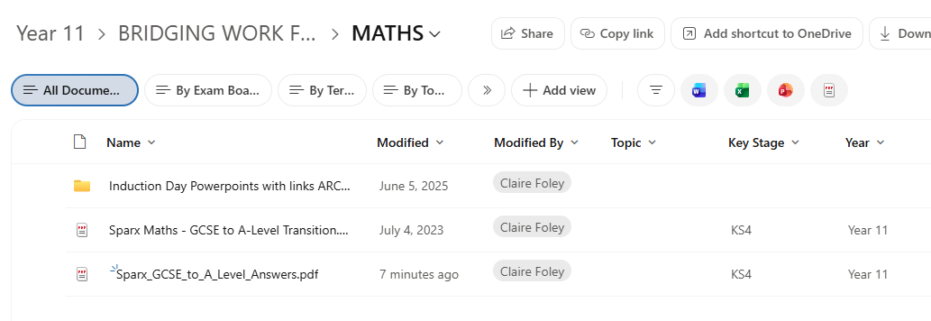
Preparation work for September
This is the booklet that you will be given today. Work steadily through it over the Summer break

Slide 13
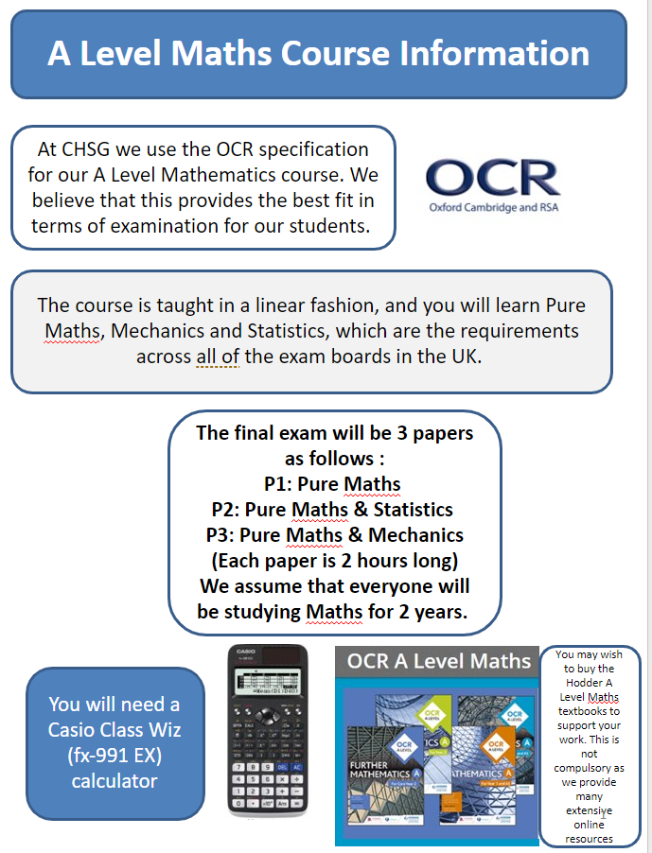
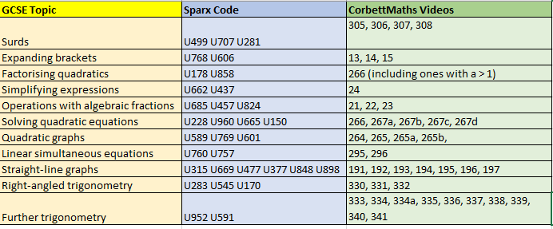
Entry Requirements
Grade 7 or better in GCSE Maths
Bridging work

Slide 14
What now?
Ensure that you start work TODAY
Use Sparx/CorbettMaths to help you study
This work needs to be brought in, COMPLETED when you enroll in August
Make a study plan so that you keep on top of it
Best of luck with your results! See you in August……

