Slide 1

A-Level Economics Bridging Work
Section | Page Number
Course Overview | 2 - 7
PLC and diagnostic check | 8 - 12
Home Learning Charter & Reading List | 13 - 16
VESPA & VESPA Audit | 17 - 19
Pre-Course Planning | 20 - 21
Pre-Course Bridging Work | 22 –32
Additional Notes | 33 - 34

Slide 2
Edexcel A-Level Economics A:
Course/qualification Overview

Slide 3
Student Reflection Section
Why did I choose Economics?
What I hope to gain from this is…..
In the future, I would like to…..
Overview of the Specification
What will I learn?
You will:
develop an interest in, and enthusiasm for, the subject
appreciate the contribution of economics to the understanding of the wider economic and social environment
develop an understanding of a range of concepts and an ability to use those concepts in a variety of different contexts
use an enquiring, critical and thoughtful approach to the study of economics and develop an ability to think as an economist
understand that economic behaviour can be studied from a range of perspectives
develop analytical and quantitative skills, together with qualities and attitudes that will equip them for the challenges, opportunities and responsibilities of adult and working life
Who will teach me?
You will have a mix of specialist Economics teachers throughout the 2-year course. These will include Mr. Stockwell and Mr Jeyasothy.
What work will I do?
The Edexcel Economics A-Level comprises of 4 compulsory modules, which are externally examined in the summer of Year 13 in 3 synoptic examination papers. Details of the four units can be seen on the next two pages

Slide 4
Theme 1: Introduction to markets and market failure
This theme is one of two in this qualification that focuses on microeconomics. This theme introduces students to the microeconomic nature of economics, looking at economic problems and the ways economists think and work. Students will need to build upon the knowledge, skills and understanding developed from Theme 1 in Theme 3, making connections across these two microeconomic themes for Paper 1, and across Themes 1, 2, 3 and 4 in Paper 3. Teaching approaches to content must reflect this. Students will need to apply their knowledge and understanding to both familiar and unfamiliar contexts in the assessments and demonstrate an awareness of current economic events and policies
In this theme students will consider how markets work, looking at how supply and demand interact to allocate resources in local, national and international markets. They will learn how to apply supply and demand analysis to real-world situations and be able to offer explanations of consumer behaviour. This will involve looking at both how consumers act in a rational way to maximise utility and how firms maximise profit, but also why consumers may not behave rationally. Having investigated how markets work, students will then look at market failure. They will look at the nature and causes of market failure before considering the strengths and weaknesses of possible government intervention to remedy market failures. This theme will provide a coherent coverage of microeconomic content with students drawing on local, national and global contexts.
Theme 2: The UK economy – performance and policies
This theme is one of two in this qualification that focuses on macroeconomics. This theme introduces the key measures of economic performance and the main instruments of economic policy primarily in a UK context. Students will need to build upon the knowledge, skills and understanding developed from Theme 2 in Theme 4, making connections across these two macroeconomic themes for Paper 2, and across Themes 1, 2, 3 and 4 in Paper 3. Teaching approaches to content must reflect this. Students will need to apply their knowledge and understanding to both familiar and unfamiliar contexts in the assessments and demonstrate an awareness of current economic events and policies.
Students will be introduced to the aggregate demand/aggregate supply model so that they can use it to analyse changes in real output and the price level. They will: examine the use of demand-side policies, supply-side policies and direct controls as means of improving an economy's performance; recognise the underlying assumptions; predict the likely impact and effectiveness of such policies; and consider these in an historical context. Students should consider the different approaches that may be used by policymakers to address macroeconomic issues and be able to identify the criteria for success. Students should have knowledge of the UK economy in the last 10 years. This theme will provide a coherent coverage of macroeconomic content with students drawing on local and national contexts, as appropriate

Slide 5
Theme 3: Business behaviour and the labour market
This theme builds on the content of Theme 1: Introduction to markets and market failure and focuses on business economics. Students will need to build upon the knowledge, skills and understanding developed from Theme 1 in Theme 3, making connections across these two microeconomic themes in Paper 1, and across Themes 1, 2, 3 and 4 in Paper 3. Teaching approaches to content must reflect this. Students will need to apply their knowledge and understanding to both familiar and unfamiliar contexts in the assessments and demonstrate an awareness of current economic events and policies
This theme examines how the number and size of market participants, and the level of contestability, affect the pricing and nature of competition among firms. Students will consider the size and growth of firms through exploring organic growth, mergers and takeovers. They will look at the reasons for demergers and why some firms tend to remain small. Students will look at the rational assumption that firms are profit maximisers and then challenge this by looking at alternative business objectives. Revenues, costs and profits are explored before linking these ideas to different market structures. Students will then be able to analyse and evaluate the pricing and output decisions of firms in different contexts and understand the role of competition in business decision making. Supply and demand analysis is specifically applied to the labour market to see how wages are determined in competitive and non-competitive markets. At the end of this theme students should be capable of making an appraisal of government intervention aimed at promoting competitive markets.
Theme 4: Global Business
This theme builds on the knowledge and skills gained in Theme 2: The UK economy – performance and policies, and applies them in a global context. Students will need to build upon the knowledge, skills and understanding developed from Theme 2 in Theme 4, making connections across these two macroeconomic themes in Paper 2, and across Themes 1, 2, 3 and 4 in Paper 3. Teaching approaches to content must reflect this. Students will need to apply their knowledge and understanding to both familiar and unfamiliar contexts in the assessments and demonstrate an awareness of current economic events and policies.
Students will be expected to understand the significance of globalisation, international trade, the balance of payments and exchange rates. They will examine public finance, macroeconomic policies and the role of the financial sector in a global context. Students will consider the factors influencing the growth and development of emerging and developing countries. In examining these areas, application, analysis and evaluation of economic models is required as well as an ability to assess policies that might be used to address national and global economic challenges. Students should develop an awareness of trends in the global economy over the last 25 years through wider reading and research so that they can include relevant examples in their analysis and evaluation

Slide 6
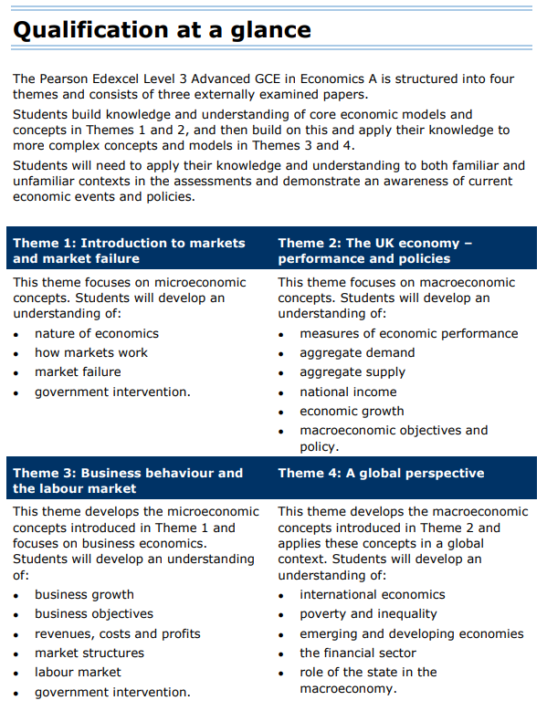

Slide 7
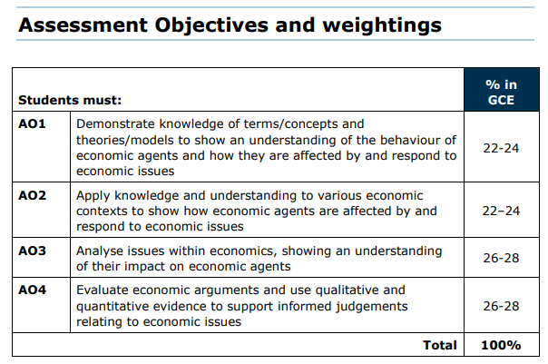
The A level Economics Assessment Objectives have been revised. The objectives have been made more explicit to exemplify the skills developed through the A level specifications.
Note; the weighting for the three exam papers is different. Paper 1 & Paper 2 will be marked up by 1.17% per mark and paper 3 will be marked at its raw grade.

Slide 8
Edexcel A-Level Economics:
PLC
This is the course overview of units and lessons. Go through this section by ticking the boxes where you feel you have some knowledge from your GCSE study from year 11

Slide 9

PLC – Theme 1
This is the course overview of units and lessons. Go through this section by ticking the boxes where you feel you have some knowledge from your GCSE study from year 11
Topic | Theme 1: Introduction to markets and market failure | Check
1.1 Nature of economics | 1.1.1 Economics as a social science
 | 1.1.2 Positive and normative economic statements
 | 1.1.3 The economic problem
 | 1.1.4 Production possibility frontiers
 | 1.1.5 Specialisation and the division of labour
 | 1.1.6 Free market economies, mixed economy and command economy
1.2 How markets work | 1.2.1 Rational decision making
 | 1.2.2 Demand
 | 1.2.3 Price, income and cross elasticities of demand
 | 1.2.4 Supply
 | 1.2.5 Elasticity of supply
 | 1.2.6 Price determination
 | 1.2.7 Price mechanism
 | 1.2.8 Consumer and producer surplus
 | 1.2.9 Indirect taxes and subsidies
 | 1.2.10 Alternative views of consumer behaviour
1.3 Market failure | 1.3.1 Types of market failure
 | 1.3.2 Externalities
 | 1.3.3 Public goods
 | 1.3.4 Information gaps
1.4 Government intervention | 1.4.1 Government intervention in markets
 | 1.4.2 Government Failure

Slide 10
PLC – Theme 2
This is the course overview of units and lessons. Go through this section by ticking the boxes where you feel you have some knowledge from your GCSE study from year 11
Topic | Theme 2: The UK economy – performance and policies | Check
2.1 Measures of economic performance | 2.1.1 Economic growth
 | 2.1.2 Inflation
 | 2.1.3 Employment and unemployment
 | 2.1.4 Balance of payments
2.2 Aggregate demand (AD) | 2.2.1 The characteristics of AD
 | 2.2.2 Consumption (C)
 | 2.2.3 Investment (I)
 | 2.2.4 Government expenditure (G)
 | 2.2.5 Net trade (X-M)
2.3 Aggregate supply (AS) | 2.3.1 The characteristics of AS
 | 2.3.2 Short-run AS
 | 2.3.3 Long-run AS
2.4 National income | 2.4.1 National income
 | 2.4.2 Injections and withdrawals
 | 2.4.3 Equilibrium levels of real national output
 | 2.4.4 The multiplier
2.5 Economic growth | 2.5.1 Causes of growth
 | 2.5.2 Output gaps
 | 2.5.3 Trade (business) cycle
 | 2.5.4 The impact of economic growth
2.6 Macroeconomic objectives and policies | 2.6.1 Possible macroeconomic objectives
 | 2.6.2 Demand-side policies
 | 2.6.3 Supply-side policies
 | 2.6.4 Conflicts and trade-offs between objectives and policies

Slide 11
PLC – Theme 3
This is the course overview of units and lessons. Go through this section by ticking the boxes where you feel you have some knowledge from your GCSE study from year 11
Topic | Theme 3: Business behaviour and the labour market | Check
3.1 Business growth | 3.1.1 Sizes and types of firms
 | 3.1.2 Business growth
 | 3.1.3 Demergers
3.2 Business objectives | 3.2.1 Business objectives
3.3 Revenues, costs and profits | 3.3.1 Revenue
 | 3.3.2 Costs
 | 3.3.3 Economies and diseconomies of scale
 | 3.3.4 Normal profits, supernormal profits and losses
3.4 Market structures | 3.4.1 Efficiency
 | 3.4.2 Perfect competition
 | 3.4.3 Monopolistic competition
 | 3.4.4 Oligopoly
 | 3.4.5 Monopoly
 | 3.4.6 Monopsony
 | 3.4.7 Contestability
3.5 Labour market | 3.5.1 Demand for labour
 | 3.5.2 Supply of labour
 | 3.5.3 Wage determination in competitive and non-competitive markets
3.6 Government intervention | 3.6.1 Government intervention
 | 3.6.2 The impact of government intervention

Slide 12
PLC –Theme 4
This is the course overview of units and lessons. Go through this section by ticking the boxes where you feel you have some knowledge from your GCSE study from year 11
Topic | Theme 4: A global perspective | Check
4.1 International economics | 4.1.1 Globalisation
 | 4.1.2 Specialisation and trade
 | 4.1.3 Pattern of trade
 | 4.1.4 Terms of trade
 | 4.1.5 Trading blocs and the World Trade Organisation (WTO)
 | 4.1.6 Restrictions on free trade
 | 4.1.7 Balance of payments
 | 4.1.8 Exchange rates
 | 4.1.9 International competitiveness
4.2 Poverty and inequality | 4.2.1 Absolute and relative poverty
 | 4.2.2 Inequality
4.3 Emerging and developing economies | 4.3.1 Measures of development
 | 4.3.2 Factors influencing growth and development
 | 4.3.3 Strategies influencing growth and development
4.4 The financial sector | 4.4.1 Role of financial markets
 | 4.4.2 Market failure in the financial sector
 | 4.4.3 Role of central banks
4.5 Role of the state in the macroeconomy | 4.5.1 Public expenditure
 | 4.5.2 Taxation
 | 4.5.3 Public sector finances
 | 4.5.4 Macroeconomic policies in a global context

Slide 13
Edexcel A-Level Economics:
Home learning Charter and Reading List

Slide 14
CHSG Key Stage 5 Home learning Charter
Purpose
To provide a structured approach to home learning that enhances the academic outcomes, ensures consistent practice, and prepares our students for independent study required in higher education and future careers.
Home learning Guidelines
Daily Home learning Allocation:
  For every lesson studied at school, an equivalent of 1 hour of home learning is expected.
  This can include reading, writing, assessments, research, and project work.
Weekly Planning:
  Students should review their weekly timetable and allocate specific study periods each day for completing their home learning.
  Prioritise tasks based on due dates and difficulty level.
Flipped Learning:
  At least 2 per half term, students will engage in flipped learning tasks.
  These tasks involve pre-class preparation such as watching videos, reading articles, or completing exercises that will be discussed in the next lesson.
  Teachers will provide clear instructions and resources for flipped learning activities.
Development of Challenge:
  Home learning tasks will be designed to challenge students and push their understanding beyond the classroom.
  Engage in higher-order thinking tasks such as analysis, evaluation, and synthesis of information.
  Take on challenging problems and projects that require creative and critical thinking.
Building Knowledge:
  Regularly review and consolidate classroom learning to build a strong knowledge foundation.
  Engage in additional reading and research to deepen understanding of subject material.
  Create summary notes and mind maps to connect different concepts.
Thinking Hard:
  Tasks will be designed to encourage deep thinking and intellectual engagement.

Slide 15
CHSG Key Stage 5 Home learning Charter
  Solve complex problems and case studies that require sustained thought and effort.
Building Resilience:
  Approach difficult tasks with a positive mindset, viewing challenges as opportunities to grow.
  Develop resilience by consistently working through challenging problems and seeking solutions.
  Learn from feedback and mistakes, using them as a basis for improvement and learning.
Assessment and Feedback:
  Home learning will be regularly assessed to monitor progress and understanding.
  Constructive feedback will be provided to guide improvement.
Study Environment:
  Create a quiet and organised study space at home.
  Minimize distractions such as mobile phones, TV, and social media during home learning time.
  Utilise S6, S12 and Careers Centre effectively during your study periods.
Time Management:
  Use planners or digital calendars to track home learning deadlines and plan study periods.
  Break down larger tasks into manageable chunks and set specific goals for each session.
Support and Resources:
  Use school resources such as the Massolit, J-Stor, study guides, and online platforms to support home learning.
Parental Involvement:
  Parents/carers are encouraged to support their child’s home learning by providing a conducive environment and monitoring progress.
Balance and Well-being:
  Ensure a balanced approach to home learning and take regular breaks during study sessions to avoid burnout.
Commitment to Excellence
By adhering to the CHSG Home learning Charter, students will develop the discipline and skills necessary for academic success and lifelong learning. At CHSG we are committed to supporting each student in their journey and ensuring that home learning is a valuable and rewarding experience.

Slide 16
KS5 Reading Journey
General reading There are a number of interesting books that are written in more layman's terms to relate economics to everyday life. All of these books are relatively new, witty and provide excellent overall background knowledge.
Todd G. Buchholz New Ideas from Dead Economists: An Introduction to Modern Economic Thought
Tim Harford, The Undercover Economist (See also www.timharford.com)
Steven D. Levitt Freakonomics: A Rogue Economist Explores the Hidden Side of Everything
John Kay Everlasting Light Bulbs: How Economics Illuminates the World
Charles Wheelan Naked Economics - Undressing the Dismal Science
Stephen E. Landsburg The Armchair Economist: Economics and Everyday Life
David Smith Free Lunch
Diane Coyle The Soulful Science: What Economists Really Do & Why It Matters
Additional readings:
Aspirational Reading - these are books that you could/should read if they are interested in studying this subject further Post 18. These books are strongly recommended if you are aiming for Grade A*/A in this subject.
Choice Factory (Richard Shotton) – a story of 25 behavioural biases that influence what we buy
Economics for the Common Good (Jean Tirole) – applied micro from a recent Nobel prize winner
GDP: A Brief but Affectionate History (Professor Diane Coyle) – really good on the GDP / well-being debate
Great Economists: How Their Ideas Can Help Us Today (Linda Yueh) – perspectives on contemporary issue
A very useful book to have is The Penguin Dictionary of Economics by G Bannock et al.
Up to date reading & watching Regular coverage of economic issues appears in serious newspapers such as The Times and Sunday Times, The Independent, Financial Times, The Guardian, and of course The Economist. The BBC News website is also an excellent source of relevant contemporary articles. The A Level magazines Economic Review and Economics Today always have up to date articles and analysis of topics as well as exam tips and study skills. Finally, TV programmes such as Panorama or the Money Programme often feature economic related material as do daily news programmes.

Slide 17
Edexcel A-Level Economics:
VESPA Skills

Slide 18






VESPA Skills
The VESPA model is based around 5 key components to student success, providing a framework for students to develop study skills. Below are the skills developed in Economics A-Level
Skill- Economics A Level | How to show it
Knowledge (AO1) | Am I clear on the key concepts, theories, methods & models for each area of Micro and Macro Economics concepts Am I clear on the how individuals, organisations, markets and economics are affected by and respond to business issues?
Understanding (AO1) | Am I showing the examiner that I have an understanding of the key economics systems ?
Application (AO2) | Can I apply my knowledge and understanding to various Economic contexts? Can I show how individuals and organisations are affected by/respond to the issue?
Analysis (AO3) | Can I analyse issues within economics, showing an understanding of the impact? Have I identified identifying different perspectives? Have I supported the strongest viewpoint? Have I offered an alternative viewpoint?
Evaluation (AO4) | Can I consider the qualitative and quantitative evidence? Can I make informed judgements showing decisive decisions on economic theory and practice? Can I develop evidence-based solutions to economic ideas?
Written structure | Have I applied the correct structure for essay style questions? Can I structure my paragraphs with AO1, 2, 3 &4 as the basic layout? Have I weighed up both arguments in both the main body of text and conclusion? Have I included an introduction with key definitions, clear arguments and a conclusion?
Vision is about having a clear goal; it's about making the connection between the work you are doing and the reason for doing it. In simple terms its about knowing the outcomes you want to achieve.
Sometimes called "academic perseverance" effort refers to how much hard work you do. It is fair to say that the absence of effort pretty much guarantees failure; however more effort on its own is not a guarantee of success.
Systems is about two things:
1) A System to organise learning so students can make sense of everything
2) A System to organise their time so students can complete key tasks to meet deadlines.
Practice represents exactly what learners do with the time they put into their studies. Not the "How much" of study but the "How".
There are four elements to developing students attitude (in relation to performance virtues). These are confidence, emotional control, academic buoyancy and growth mindset.

Slide 19
VESPA Skills Pre-course Audit
The VESPA model is based around 5 key components to student success, providing a framework for students to develop study skills. Below are the skills developed in Economics A-Level
Skill- Economics A Level | How to show it
Knowledge (AO1) | Am I clear on the key concepts, theories, methods & models for each area of Micro and Macro Economics concepts Am I clear on the how individuals, organisations, markets and economics are affected by and respond to business issues?
Understanding (AO1) | Am I showing the examiner that I have an understanding of the key economics systems ?
Application (AO2) | Can I apply my knowledge and understanding to various Economic contexts? Can I show how individuals and organisations are affected by/respond to the issue?
Analysis (AO3) | Can I analyse issues within economics, showing an understanding of the impact? Have I identified identifying different perspectives? Have I supported the strongest viewpoint? Have I offered an alternative viewpoint?
Evaluation (AO4) | Can I consider the qualitative and quantitative evidence? Can I make informed judgements showing decisive decisions on economic theory and practice? Can I develop evidence-based solutions to economic ideas?
Written structure | Have I applied the correct structure for essay style questions? Can I structure my paragraphs with AO1, 2, 3 &4 as the basic layout? Have I weighed up both arguments in both the main body of text and conclusion? Have I included an introduction with key definitions, clear arguments and a conclusion?
 | Vision – Do I feel I know where the course is going? | Effort – Am I prepared for the level of effort required to step-up from GCSEs? | Systems – Do I know the systems of the exams and themes of the course | Practice – Have I looked over the course spec to work out HOW I need to Study? | Attitude – do I have the 4 attributes for the right attitude to my study
Yes
No
Developing

Slide 20
Edexcel A-Level Economics:
Pre-course Planning

Slide 21
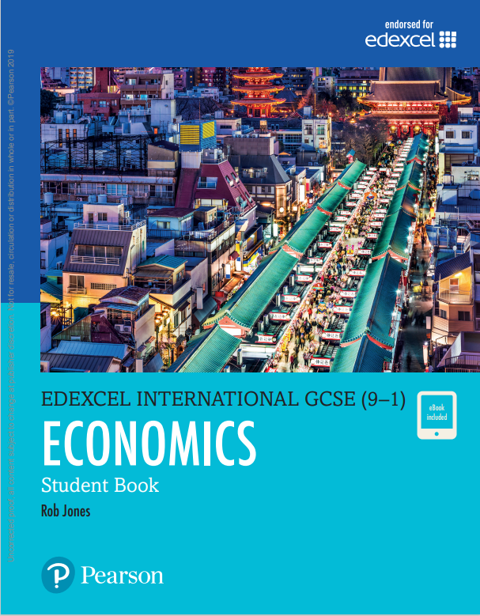
Pre-Course Administration and Preparation Tasks:
Consider purchasing/downloading a course textbook, via this link:
2. Purchase/loan the other books on your reading list (Refer back to Page 14 – recommend you purchase second hand from Amazon).
3. Purchase an A4 ‘Lever Arch’ folder, divide into 4 sections and insert a set of file dividers with the following tab headings as detailed below:
Theme 1: Markets & Market Failures
Theme 2: The UK Economy - Performance and Policies
Theme 3: Business Behaviour and Labour Market
Theme 4: A Global Perspective
4. Read and undertake the PLC audit on pages 8-12
5. Read the VESPA page to grasp the key skills required for the subject on pages 17-19. Complete the Vespa Audit on the next page
6.. Complete Summer Bridging Work on the next pages provided (pages 22-32). Answer the questions to the best of your ability and with detail. Feel free to use the internet/research to guide you however, do not use AI or the answers you find online
If you get stuck, would like support, or have questions, please email Mr Stockwell at jimstockwell@carshaltongirls.org.uk
Edexcel Economics Textbook pdf

Slide 22
Edexcel A-Level Economics:
Pre-course Bridging Work

Slide 23
1. What Is Economics?
Task:
Research the definition of economics and explain the difference between microeconomics (individual and business decisions) and macroeconomics (national and global economy).
Activity:
Create a poster or one-page infographic (digital or hand-drawn) with:
• A definition of economics
• A brief explanation of micro vs macro
• 2 examples for each branch
Example:
Microeconomics Example: A coffee shop deciding how much to charge for a latte.
Macroeconomics Example: The UK government setting interest rates to control inflation.

Slide 24
2. The Basic Economic Problem
Task:
Explore the concept of scarcity, choice, and opportunity cost. Why can’t we have everything we want?
Activity:
Write a paragraph about a personal decision you’ve made recently (e.g., choosing to go out instead of studying).
Identify the resources involved (e.g., time, money)
Explain the opportunity cost of that decision
Example:
"I chose to go to the cinema with friends instead of working on my part-time job shift. The opportunity cost was the £25 I could have earned.“
______________________________________________________________________________________________________________________________________________________________________________________________________________________________________________________________________________________________________________________________________________________________________________________________________________________________________________________________________________________________________________________________________________________________________________________________________________________________________________________________________________________________________________________________________________________________________________________________________________________________________________________________________________________________________________________________________________________________________________________________________________________________________________________________________________________________________________________________________________________________________________________________________________

Slide 25
3. Needs vs Wants
Task:
Research the difference between needs (essential for survival) and wants (non-essential desires).
Activity:
Make a table with two columns listing 5 things you use daily. Classify them as a need or a want, and justify your answer.
Example:
Item | Need or Want | Why?
Water | Need | Essential for survival
Smartphone | Want | Useful but not essential
Food | Need | Required for health and energy
Netflix | Want | Entertainment, not a necessity
School books | Need | Essential for education

Slide 26
4. Types of Economic Systems
Task:
Explore free market, command, and mixed economies. What are their features and differences?
Activity:
Choose two countries (e.g., USA and North Korea). Create a comparison chart showing:
Type of economy
Who makes economic decisions
How resources are allocated
Example:
Feature | USA (Free Market) | North Korea (Command)
Economic System | Free Market | Command
Key Decision-Maker | Private individuals | Government
Prices Set By | Supply and demand | Central planning

Slide 27
5. Factors of Production
Task:
Learn about the four factors of production: land, labour, capital, enterprise.
Activity:
Pick a common product (e.g., a chocolate bar) and identify how each factor contributes to its production. Present in a paragraph or diagram.
Example:
Land: Cocoa beans from Ghana
Labour: Workers in the factory
Capital: Machinery for packaging
Enterprise: The owner who organises the process and takes financial risk

Slide 28
6. Role of Government in the Economy
Task:
Research how governments influence the economy via taxation, spending, and regulations.
Activity:
Find a recent news article (e.g., BBC, Guardian) on a government economic policy (like tax cuts, subsidies, or increasing benefits).
Summarise what the policy is
Explain who benefits or loses from it
Example:
Policy: The UK increases the National Minimum Wage
Effect: Workers earn more, but small businesses may face higher costs
_________________________________________________________________________________________________________________________________________________________________________________________________________________________________________________________________________________________________________________________________________________________________________________________________________________________________________________________________________________________________________________________________________________________________________________________________________________________________________________________________________________________________________________________________________________________________________________________________________________________________________________________________________________________________________________________________________________________________________________________________________________________________________________________________________________________________________________________________________________________

Slide 29
7. Inflation and Prices
Task:
Understand what inflation is and why rising prices affect people differently.
Activity:
Pick 3 everyday items (e.g., loaf of bread, cinema ticket, train fare). Research prices 10 years ago vs. today and calculate the percentage increase.
Example:
Item | Price in 2015 | Price in 2025 | % Increase
Bread | £1.00 | £1.60 | 60%
Cinema Ticket | £7.00 | £12.00 | 71.4%
Train Fare | £5.00 | £8.50 | 70%

Slide 30
8. Supply and Demand Basics
Task:
Explore how supply and demand determine prices in a market.
Activity:
Draw a basic supply and demand graph. Then, choose an example (e.g., ice cream in summer) and show how demand changes, shifting the curve and affecting price.
Example:
In hot weather, the demand for ice cream increases, shifting the demand curve right. Price rises from £2 to £2.50 due to higher demand.

Slide 31
9. The Circular Flow of Income
Task:
Learn how money moves between households, firms, and the government in the economy.
Activity:
Create a labelled diagram of the circular flow of income. Include:
Households
Firms
Government (optional)
Arrows showing income, spending, and goods/services
Example:
Households provide labour to firms and receive wages; they then use those wages to buy goods and services from firms.

Slide 32
10. Careers and Relevance of Economics
Task:
Discover where economics is used in the real world.
Activity:
Find a career profile (from a site like Prospects.ac.uk or BBC Bitesize) or interview someone working in business, government, or finance.
Write a short reflection:
What do they do?
How does economics help them?
What skills are important?
Example:
An economist at the Bank of England helps forecast inflation and interest rates. They use data analysis and economic theory to guide policy.

Slide 33
Additional Notes Section
________________________________________________________________________________________________________________________________________________________________________________________________________________________________________________________________________________________________________________________________________________________________________________________________________________________________________________________________________________________________________________________________________________________________________________________________________________________________________________________________________________________________________________________________________________________________________________________________________________________________________________________________________________________________________________________________________________________________________________________________________________________________________________________________________________________________________________________________________________________________________________________________________________________________________________________________________________________________________________________________________________________________________________________________________________________________________________________________________________________________________________________________________________________________________________________________________________________________________________________________________________________________________________________________________________________________________________________________________________________________________________________________________________________________________________________

Slide 34
Additional Notes Section
________________________________________________________________________________________________________________________________________________________________________________________________________________________________________________________________________________________________________________________________________________________________________________________________________________________________________________________________________________________________________________________________________________________________________________________________________________________________________________________________________________________________________________________________________________________________________________________________________________________________________________________________________________________________________________________________________________________________________________________________________________________________________________________________________________________________________________________________________________________________________________________________________________________________________________________________________________________________________________________________________________________________________________________________________________________________________________________________________________________________________________________________________________________________________________________________________________________________________________________________________________________________________________________________________________________________________________________________________________________________________________________________________________________________________________________

