Slide 1

A-Level Business Studies Bridging Work
Section | Page Number
Course Overview | 2 - 7
PLC and diagnostic check | 8 - 10
Home Learning Charter & Reading List | 11 - 14
VESPA & VESPA Audit | 15 - 17
Pre-Course Planning | 18 - 19
Pre-Course Bridging Work | 20 – 25
Additional Notes | 26 - 27

Slide 2
Edexcel A-Level Business Studies:
Course/qualification Overview

Slide 3
Student Reflection Section
Why did I choose Business Studies?
What I hope to gain from this is…..
In the future, I would like to…..
Overview of the Specification
What will I learn?
You will:
Gain a broad understanding of business;
Develop skills, knowledge and understanding for use in the business world and higher education;
Apply learning in a practical way to what actually goes on in the real world;
Follow a programme of study that enables progression to both higher education and employment within business;
Develop Key Skills that are highly valued by employers and universities;
Gain confidence through developing independent learning skills.
Who will teach me?
You will have a mix of specialist Business teachers throughout the 2-year course. These will include Mr. Stockwell and Ms Kita.
What work will I do?
The Edexcel Business A-Level comprises of 4 compulsory modules, which are externally examined in the summer of Year 13 in 3 synoptic examination papers. Details of the four units can be seen on the next two pages

Slide 4
Theme 1: Marketing and people
In this theme, you will be introduced to the market, explore the marketing and people functions, investigate entrepreneurs and business start-ups. You will need to build upon the knowledge, skills and understanding developed in this theme when studying Theme 4, making connections across these two themes in Paper 1, and across Themes 1, 2, 3 and 4 in Paper 3. Therefore, you will need to apply your knowledge and understanding to both familiar and unfamiliar contexts in the assessments and demonstrate an awareness of current business issues.
This theme enables you to understand how businesses identify opportunities and to explore how businesses focus on developing a competitive advantage through interacting with customers.
You will develop an understanding of how businesses need to adapt their marketing to operate in a dynamic business environment. This theme also considers people, exploring how businesses recruit, train, organise and motivate employees, as well as the role of enterprising individuals and leaders.
You must investigate different types and sizes of organisation in various business sectors and environments, and in local, national and global contexts.
To develop your knowledge, skills and understanding in business, you need to have acquired competence in quantitative skills that are relevant to and applied in the context of this theme
Theme 2: Managing Business Activities
In this theme, you will explore the finance and operations functions, and investigate external influences on business. You will need to build upon the knowledge, skills and understanding developed in this theme when studying Theme 3, making connections across these two themes in Paper 2, and across Themes 1, 2, 3 and 4 in Paper 3. Therefore, you will need to apply your knowledge and understanding to both familiar and unfamiliar contexts in the assessments and demonstrate an awareness of current business issues.
This theme enables you to develop an understanding of raising and managing finance, and measuring business performance. The theme outlines the importance of using resources efficiently within a business to ensure that goods or services can be delivered effectively and efficiently, and to a high quality.
You will also consider the external influences that have an impact on businesses, including economic and legal factors. You must investigate different types and sizes of organisation in various business sectors and environments, and in local, national and global contexts.
To develop their knowledge, skills and understanding in business, students need to have acquired competence in quantitative skills that are relevant to and applied in the context of this theme

Slide 5
Theme 3: Business Decisions and Strategies
In this theme, you will develop your understanding of the concepts introduced in Theme 2 and explore influences on business strategy and decision-making. You will need to build upon the knowledge, skills and understanding developed in Theme 2 in this theme, making connections across these two themes in Paper 2, and across Themes 1, 2, 3 and 4 in Paper 3. Once again, you will need to apply your knowledge and understanding to both familiar and unfamiliar contexts in the assessments and demonstrate an awareness of current business issues.
This theme moves from functions to strategy, enabling you to develop your understanding of the core concepts and to take a strategic view of business opportunities and issues. You will analyse corporate objectives and strategy against financial and non-financial performance measures and how businesses grow, and develop an understanding of the impact of external influences.
The theme covers the causes and effects of change and how businesses mitigate risk and uncertainty. You must investigate different types and sizes of organisation in various business sectors and environments, and in local, national and global contexts.
To develop your knowledge, skills and understanding in business, students need to have acquired competence in quantitative skills that are relevant to and applied in the context of this theme
Theme 4: Global Business
In this theme, you will develop your understanding of the concepts introduced in Theme 1 and activity in a global context. You will need to build upon the knowledge, skills and understanding developed in Theme 1 in this theme, making connections across these two themes in Paper 1, and across Themes 1, 2, 3 and 4 in Paper 3. Once again, you will need to apply your knowledge and understanding to both familiar and unfamiliar contexts in the assessments and demonstrate an awareness of current business issues.
You will investigate businesses that trade on a global scale and explore their reasons for doing so. You will develop an understanding of the globally competitive environment and consider the ethical and moral dimensions of global business activities.
You must investigate different types and sizes of organisation in various business sectors and environments, and in local, national and global contexts.
To develop your knowledge, skills and understanding in business, you will need to have acquired competence in quantitative skills that are relevant to and applied in the context of this theme

Slide 6
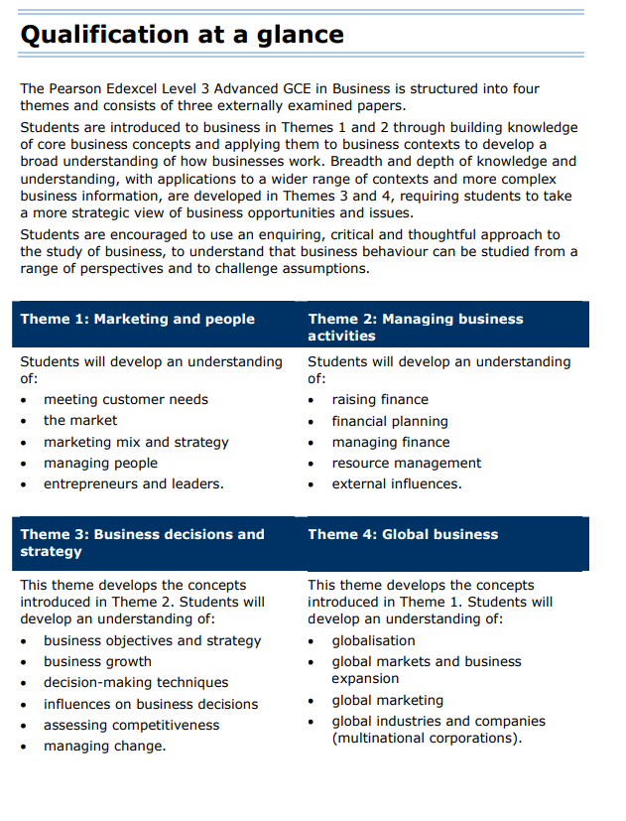

Slide 7
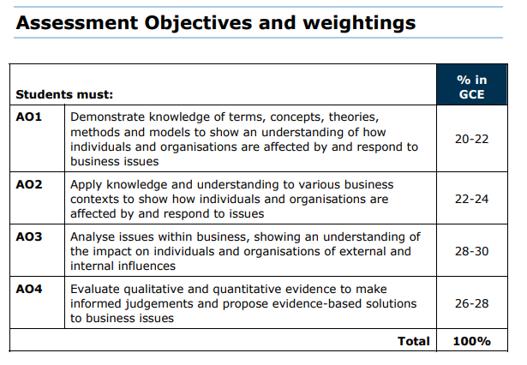
The A level Business Assessment Objectives have been revised. The objectives have been made more explicit to exemplify the skills developed through the A level specifications.
Note; the weighting for the three exam papers is different. Paper 1 & Paper 2 will be marked up by 1.17% per mark and paper 3 will be marked at its raw grade.

Slide 8
Edexcel A-Level Business Studies:
PLC
This is the course overview of units and lessons. Go through this section by ticking the boxes where you feel you have some knowledge from your GCSE study from year 11

Slide 9

PLC – Theme 1 & Theme 2
This is the course overview of units and lessons. Go through this section by ticking the boxes where you feel you have some knowledge from your GCSE study from year 11
Theme 1 PLC - Marketing and People
Theme 2 PLC - Managing Business Activities
Topic | Content | Check
1.1 Meeting Customer Needs | 1.1.1 The Market
 | 1.1.2 Market Research
 | 1.1.3 Market Positioning
1.2 The Market | 1.2.1 Demand
 | 1.2.2 Supply
 | 1.2.3 Markets
 | 1.2.4 Price Elasticity of Demand (PED)
 | 1.2.5 Income Elasticity of Demand (YED)
1.3 Marketing mix and Strategy | 1.3.1 Product/Service Design
 | 1.3.2 Branding and Promotion
 | 1.3.3 Pricing Strategies
 | 1.3.4 Distribution
 | 1.3.5 Marketing Strategy
1.4 Managing People | 1.4.1 Approaches to Staffing
 | 1.4.2 Recruitment, Selection and Training
 | 1.4.3 Organisation Design
 | 1.4.4 Motivation in Theory and Practice
 | 1.4.5 Leadership
1.5 Entrepreneurs and Leaders | 1.5.1 Role of the Entrepreneur
 | 1.5.2 Entrepreneurial Motives and Characteristics
 | 1.5.6 Moving from Entrepreneur to Leader
 | 1.5.3 Business Objectives
 | 1.5.4 Forms of Business
 | 1.5.5 Business Choices
Topic | Content | Check
2.1 Raising Finances | 2.1.1 Internal Finance
 | 2.1.2 External Finance
 | 2.1.3 Liability
 | 2.1.4 Planning
2.2 Financial Planning | 2.2.1 Sales Forecasting
 | 2.2.2 Sales, Revenue and Costs
 | 2.2.3 Break-even
 | 2.2.4 Budgets
2.3 Managing Finances | 2.3.1 Profit
 | 2.3.2 Liquidity
 | 2.3.3 Business Failure
2.4 Resource Management | 2.4.1 Production, Productivity and Efficiency
 | 2.4.2 Capacity utilisation
 | 2.4.3 Stock Control
 | 2.4.4 Quality Management
2.5 External Influences | 2.5.1 Economic Influences
 | 2.5.2 Legislation

Slide 10
PLC – Theme 3 & Theme 4
This is the course overview of units and lessons. Go through this section by ticking the boxes where you feel you have some knowledge from your GCSE study from year 11
Theme 3 PLC - Business Decisions and Strategy
Theme 4 PLC - Global Business
Topic | Content | Check
3.1 Business Objectives and Strategies | 3.1.1 Corporate Objectives
 | 3.1.2 Theories of Corporate Strategy
 | 3.1.3 SWOT Analysis
 | 3.1.4 Impact of External Influences
3.2 Business Growth | 3.2.1 Growth
 | 3.2.2 Mergers and Takeovers
 | 3.2.3 Organic Growth
 | 3.2.4 Reasons for Stay Small
3.3 Decision-Making Techniques | 3.3.1 Quantative Sale Forecasting
 | 3.3.2 Investment Appraisal
 | 3.3.3 Decision trees
 | 3.3.4 Critical Path Analysis
3.4 Influences on Business Decisions | 3.4.1 Corporate Influences
 | 3.4.2 Corporate Culture
 | 3.4.3 Shareholders Vs Stakeholders
 | 3.4.4 Business Ethics
3.5 Assessing Competitiveness | 3.5.1 Interpretation of Financial Statements
 | 3.5.2 Ratio Analysis
 | 3.5.3 Human Resources
3.6 Managing Change | 3.6.1 Causes and effects of Change
 | 3.6.2 Key Factors in change
 | 3.6.3 Scenario Planning
Topic | Content | Check
4.1 Globalisation | 4.1.1 Growing Economies
 | 4.1.2 Internal trade and Business Growth
 | 4.1.3 Factors Contributing to increased Globalisation
 | 4.1.4 Protetionism
 | 4.1.5 Trading Blocs
4.2 Global markets and Business Expansion | 4.2.1 Conditions that prompt Trade
 | 4.2.2 Assessment of a Country as a Market
 | 4.2.3 Assessment of a Country as a Production Location
 | 4.2.4 Reasons for Global mergers or Joint Ventures
 | 4.2.5 Global Competitiveness
4.3 Global Marketing | 4.3.1 Marketing
 | 4.3.2 Niche Markets
 | 4.3.3 Cultural and Social Issues
4.4 Global Industries and Companies (Multinational Corporations) | 4.4.1 The Impact of MNCs
 | 4.4.2 Ethics
 | 4.4.3 Controlling MNCs

Slide 11
Edexcel A-Level Business Studies:
Home learning Charter and Reading List

Slide 12
CHSG Key Stage 5 Home learning Charter
Purpose
To provide a structured approach to home learning that enhances the academic outcomes, ensures consistent practice, and prepares our students for independent study required in higher education and future careers.
Home learning Guidelines
Daily Home learning Allocation:
  For every lesson studied at school, an equivalent of 1 hour of home learning is expected.
  This can include reading, writing, assessments, research, and project work.
Weekly Planning:
  Students should review their weekly timetable and allocate specific study periods each day for completing their home learning.
  Prioritise tasks based on due dates and difficulty level.
Flipped Learning:
  At least 2 per half term, students will engage in flipped learning tasks.
  These tasks involve pre-class preparation such as watching videos, reading articles, or completing exercises that will be discussed in the next lesson.
  Teachers will provide clear instructions and resources for flipped learning activities.
Development of Challenge:
  Home learning tasks will be designed to challenge students and push their understanding beyond the classroom.
  Engage in higher-order thinking tasks such as analysis, evaluation, and synthesis of information.
  Take on challenging problems and projects that require creative and critical thinking.
Building Knowledge:
  Regularly review and consolidate classroom learning to build a strong knowledge foundation.
  Engage in additional reading and research to deepen understanding of subject material.
  Create summary notes and mind maps to connect different concepts.
Thinking Hard:
  Tasks will be designed to encourage deep thinking and intellectual engagement.

Slide 13
CHSG Key Stage 5 Home learning Charter
  Solve complex problems and case studies that require sustained thought and effort.
Building Resilience:
  Approach difficult tasks with a positive mindset, viewing challenges as opportunities to grow.
  Develop resilience by consistently working through challenging problems and seeking solutions.
  Learn from feedback and mistakes, using them as a basis for improvement and learning.
Assessment and Feedback:
  Home learning will be regularly assessed to monitor progress and understanding.
  Constructive feedback will be provided to guide improvement.
Study Environment:
  Create a quiet and organised study space at home.
  Minimize distractions such as mobile phones, TV, and social media during home learning time.
  Utilise S6, S12 and Careers Centre effectively during your study periods.
Time Management:
  Use planners or digital calendars to track home learning deadlines and plan study periods.
  Break down larger tasks into manageable chunks and set specific goals for each session.
Support and Resources:
  Use school resources such as the Massolit, J-Stor, study guides, and online platforms to support home learning.
Parental Involvement:
  Parents/carers are encouraged to support their child’s home learning by providing a conducive environment and monitoring progress.
Balance and Well-being:
  Ensure a balanced approach to home learning and take regular breaks during study sessions to avoid burnout.
Commitment to Excellence
By adhering to the CHSG Home learning Charter, students will develop the discipline and skills necessary for academic success and lifelong learning. At CHSG we are committed to supporting each student in their journey and ensuring that home learning is a valuable and rewarding experience.

Slide 14
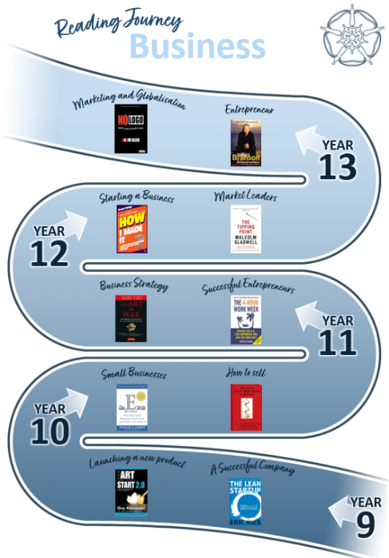
KS5 Reading Journey
Additional readings:
How I Made It: 40 Successful Entrepreneurs Reveal How They Made Millions - Rachel Bridge
An essential read for anyone that is thinking about starting their own business. Successful Entrepreneurs are interviewed about how the spotted a gap in a market, and developed a USP.
The Tipping Point: How Little Things Can Make a Big Difference - Malcolm Gladwell
A very readable and fascinating book, which looks into the reasons products become market leaders.
The Google Story - David A. Vise
An interesting investigation into the culture at Google, includes insights into the four day working week and soft management styles. The questions is; are these the things that made Google the world’s number one search engine?
The Toyota Way: 14 Management Principles from the World's Greatest Manufacturer - Jeffrey Liker
Covers Japanese Management Techniques such as Kaizen and TQM.

Slide 15
Edexcel A-Level Business studies:
VESPA Skills

Slide 16






VESPA Skills
The VESPA model is based around 5 key components to student success, providing a framework for students to develop study skills. Below are the skills developed in Business A-Level
Skill- Business Studies A Level | How to show it
Knowledge (AO1) | Am I clear on the key concepts, theories, methods & models for each area of Marketing, Managing Activities, Decisions and Strategies and Global Scenarios? Am I clear on the how individuals and organisations are affected by and respond to business issues?
Understanding (AO1) | Am I showing the examiner that I have an understanding of the English Legal system by linking legal rules and principles of the Law?
Application (AO2) | Can I apply my knowledge and understanding to various business contexts? Can I show how individuals and organisations are affected by/respond to the issue?
Analysis (AO3) | Can I analyse issues within Business, showing an understanding of the impact? Have I identified identifying different perspectives? Have I supported the strongest viewpoint? Have I offered an alternative viewpoint?
Evaluation (AO4) | Can I consider the qualitative and quantitative evidence? Can I make informed judgements showing decisive decisions on business decisions? Can I develop evidence-based solutions to business ideas?
Written structure | Have I applied the correct structure for 8, 10, 12 & 20 Mark essay? Can I structure my paragraphs with AO1, 2, 3 &4 as the basic layout? Have I weighed up both arguments in both the main body of text and conclusion? Have I included an introduction with key definitions, clear arguments and a conclusion?
Vision is about having a clear goal; it's about making the connection between the work you are doing and the reason for doing it. In simple terms its about knowing the outcomes you want to achieve.
Sometimes called "academic perseverance" effort refers to how much hard work you do. It is fair to say that the absence of effort pretty much guarantees failure; however more effort on its own is not a guarantee of success.
Systems is about two things:
1) A System to organise learning so students can make sense of everything
2) A System to organise their time so students can complete key tasks to meet deadlines.
Practice represents exactly what learners do with the time they put into their studies. Not the "How much" of study but the "How".
There are four elements to developing students attitude (in relation to performance virtues). These are confidence, emotional control, academic buoyancy and growth mindset.

Slide 17
VESPA Skills Pre-course Audit
The VESPA model is based around 5 key components to student success, providing a framework for students to develop study skills. Below are the skills developed in Business A-Level
Skill- Business Studies A Level | How to show it
Knowledge (AO1) | Am I clear on the key concepts, theories, methods & models for each area of Marketing, Managing Activities, Decisions and Strategies and Global Scenarios? Am I clear on the how individuals and organisations are affected by and respond to business issues?
Understanding (AO1) | Am I showing the examiner that I have an understanding of the English Legal system by linking legal rules and principles of the Law?
Application (AO2) | Can I apply my knowledge and understanding to various business contexts? Can I show how individuals and organisations are affected by/respond to the issue?
Analysis (AO3) | Can I analyse issues within Business, showing an understanding of the impact? Have I identified identifying different perspectives? Have I supported the strongest viewpoint? Have I offered an alternative viewpoint?
Evaluation (AO4) | Can I consider the qualitative and quantitative evidence? Can I make informed judgements showing decisive decisions on business decisions? Can I develop evidence-based solutions to business ideas?
Written structure | Have I applied the correct structure for 8, 10, 12 & 20 Mark essay? Can I structure my paragraphs with AO1, 2, 3 &4 as the basic layout? Have I weighed up both arguments in both the main body of text and conclusion? Have I included an introduction with key definitions, clear arguments and a conclusion?
 | Vision – Do I feel I know where the course is going? | Effort – Am I prepared for the level of effort required to step-up from GCSEs? | Systems – Do I know the systems of the exams and themes of the course | Practice – Have I looked over the business Buster to work out HOW I need to Study? | Attitude – do I have the 4 attributes for the right attitude to my study
Yes
No
Developing

Slide 18
Edexcel A-Level Business Studies:
Pre-course Planning

Slide 19

Pre-Course Administration and Preparation Tasks:
Consider purchasing a course textbook, via this link:
2. Purchase/loan the other books on your reading list (Refer back to Page xxx – recommend you purchase second hand from Amazon).
3. Purchase an A4 ‘Lever Arch’ folder, divide into 4 sections and insert a set of file dividers with the following tab headings as detailed below:
Theme 1: Marketing & People
Theme 2: Managing Business Activities
Theme 3: Business Decisions and Strategies
Theme 4: Global Business
4. Complete the PLC diagnostics test to see ones own level of understanding. Collect a copy of the Business Buster and the Blank PLC form from Mr Stockwell. Place in your folder ready for September
5. Read the VESPA page to grasp the key skills required for the subject. Complete the Vespa Audit on the next page
6. Complete Summer Bridging Work on the next pages provided. Answer the questions to the best of your ability and with detail. Feel free to use the internet/research to guide you however, do not use AI or the answers you find online
If you get stuck, would like support, or have questions, please email Mr Stockwell at jimstockwell@carshaltongirls.org.uk
Pearson Edexcel A level Business: Amazon.co.uk: Marcouse, Ian, Hammond, Andrew, Watson, Nigel: 9781510452701: Books

Slide 20
Edexcel A-Level Business Studies:
Pre-course Bridging Work

Slide 21
1. Business Case Study Analysis
Task: Analyse a company (e.g., a successful start-up or a large corporation). Identify key business challenges the company faced and discuss how they overcame them. Link your findings to the business concepts you've learned at GCSE (e.g., marketing, finance, operations).
_______________________________________________________________________________________________________________________________________________________________________________________________________________________________________________________________________________________________________________________________________________________________________________________________________________________________________________________________________________________________________________
2. SWOT Analysis of a Local Business
Task: Visit or research a local business (e.g., a restaurant, retail shop, or service provider). Perform a detailed SWOT analysis (Strengths, Weaknesses, Opportunities, and Threats).
Strengths
Threats
Weakness
Obstacles
_____________________________________________________________________________________________________________________________________________________________________

Slide 22
3. Business Plan Creation
Task: Develop a mock business plan for a start-up. Include sections such as the business idea, market research, financial projections, and marketing strategy.
Visit the link below for guidance on how to write a business plan, then staple your version at the top of the page
550+ Sample Business Plan Examples to Inspire Your Own — Bplans
4. Financial Management Simulation
Task: Use a basic spreadsheet (or online tool) to simulate budgeting and financial planning for a business. Include forecasting revenue, costs, and break-even analysis.
Screen shot, print and paste a copy of your budget below
Stick Spreadsheet copy here

Slide 23
5. Business Ethics Debate
Task: Research an ethical dilemma faced by a company (e.g., labour practices, environmental impact) and write a support argument on how the company should address it.
_______________________________________________________________________________________________________________________________________________________________________________________________________________________________________________________________________________________________________________________________________________________________________________________________________________________________________________________________________________________________________________
6. Customer Segmentation Exercise
Task: Choose a product and develop customer profiles based on demographics, psychographics, and buying behaviour. Present your findings and suggest strategies for targeting each segment.
_________________________________________________________________________________________________________________________________________________________________________________________________________________________________________________________________________________________________________________________________________________________________________________________________________________________________________________________________________________________________________________________________________________________________________________________________________________________________________________________________________________________________________________________________________________________________________________________________________________________________________________________

Slide 24
Case Study Question: Read the following case study about a company facing market competition in the retail industry.
"XYZ Retail, a popular clothing brand, has seen a significant decline in sales over the past year due to increased competition and changing customer preferences. The company has introduced a new marketing campaign, focusing on social media influencers and discount offers to attract younger customers."
Question:
Using the information in the case study, identify two potential reasons for XYZ Retail's decline in sales. (4 marks)
_______________________________________________________________________________________________________________________________________________________________________________________________________________________________________________________________________________________________________________________________________________________________________________________________________________________________________________________________________________________________________________
SWOT Analysis Question:
Question:
A local coffee shop has been operating for two years and has established a loyal customer base. However, it faces strong competition from larger chains like Starbucks and Costa. Using your knowledge of SWOT analysis:
Identify two strengths and two weaknesses of the coffee shop. (4 marks)
_______________________________________________________________________________________________________________________________________________________________________________________________________________________________________________________________________________________________________________________________________________________________________________________________________________________________________________________________________________________________________________

Slide 25
Marketing Strategy Question:
Question:
A new smartphone company is entering the market and wants to increase brand awareness among teenagers aged 16-18. The company has a limited marketing budget but wants to maximize the impact of its advertising.
Suggest two marketing strategies the company could use to target this age group effectively. (4 marks)
_____________________________________________________________________________________________________________________________________________________________________________________________________________________________________________________________________________________________________________________________________________________________________________________________________________________________________________________________________________________________________________________________________________________________________________________________________________________________
PESTLE Analysis Question:
Question:
A company that manufactures electric cars is considering expanding its operations to a new country.
Identify and explain two political factors that could affect the company's decision to enter this market. (4 marks)
_______________________________________________________________________________________________________________________________________________________________________________________________________________________________________________________________________________________________________________________________________________________________________________________________________________________________________________________________________________________________________________

Slide 26
Additional Notes Section
________________________________________________________________________________________________________________________________________________________________________________________________________________________________________________________________________________________________________________________________________________________________________________________________________________________________________________________________________________________________________________________________________________________________________________________________________________________________________________________________________________________________________________________________________________________________________________________________________________________________________________________________________________________________________________________________________________________________________________________________________________________________________________________________________________________________________________________________________________________________________________________________________________________________________________________________________________________________________________________________________________________________________________________________________________________________________________________________________________________________________________________________________________________________________________________________________________________________________________________________________________________________________________________________________________________________________________________________________________________________________________________________________________________________________________________

Slide 27
Additional Notes Section
________________________________________________________________________________________________________________________________________________________________________________________________________________________________________________________________________________________________________________________________________________________________________________________________________________________________________________________________________________________________________________________________________________________________________________________________________________________________________________________________________________________________________________________________________________________________________________________________________________________________________________________________________________________________________________________________________________________________________________________________________________________________________________________________________________________________________________________________________________________________________________________________________________________________________________________________________________________________________________________________________________________________________________________________________________________________________________________________________________________________________________________________________________________________________________________________________________________________________________________________________________________________________________________________________________________________________________________________________________________________________________________________________________________________________________________

Slide 28
Additional Notes Section
________________________________________________________________________________________________________________________________________________________________________________________________________________________________________________________________________________________________________________________________________________________________________________________________________________________________________________________________________________________________________________________________________________________________________________________________________________________________________________________________________________________________________________________________________________________________________________________________________________________________________________________________________________________________________________________________________________________________________________________________________________________________________________________________________________________________________________________________________________________________________________________________________________________________________________________________________________________________________________________________________________________________________________________________________________________________________________________________________________________________________________________________________________________________________________________________________________________________________________________________________________________________________________________________________________________________________________________________________________________________________________________________________________________________________________________

Slide 29
Additional Notes Section
________________________________________________________________________________________________________________________________________________________________________________________________________________________________________________________________________________________________________________________________________________________________________________________________________________________________________________________________________________________________________________________________________________________________________________________________________________________________________________________________________________________________________________________________________________________________________________________________________________________________________________________________________________________________________________________________________________________________________________________________________________________________________________________________________________________________________________________________________________________________________________________________________________________________________________________________________________________________________________________________________________________________________________________________________________________________________________________________________________________________________________________________________________________________________________________________________________________________________________________________________________________________________________________________________________________________________________________________________________________________________________________________________________________________________________________

Slide 30
Additional Notes Section
________________________________________________________________________________________________________________________________________________________________________________________________________________________________________________________________________________________________________________________________________________________________________________________________________________________________________________________________________________________________________________________________________________________________________________________________________________________________________________________________________________________________________________________________________________________________________________________________________________________________________________________________________________________________________________________________________________________________________________________________________________________________________________________________________________________________________________________________________________________________________________________________________________________________________________________________________________________________________________________________________________________________________________________________________________________________________________________________________________________________________________________________________________________________________________________________________________________________________________________________________________________________________________________________________________________________________________________________________________________________________________________________________________________________________________________

