Slide 1
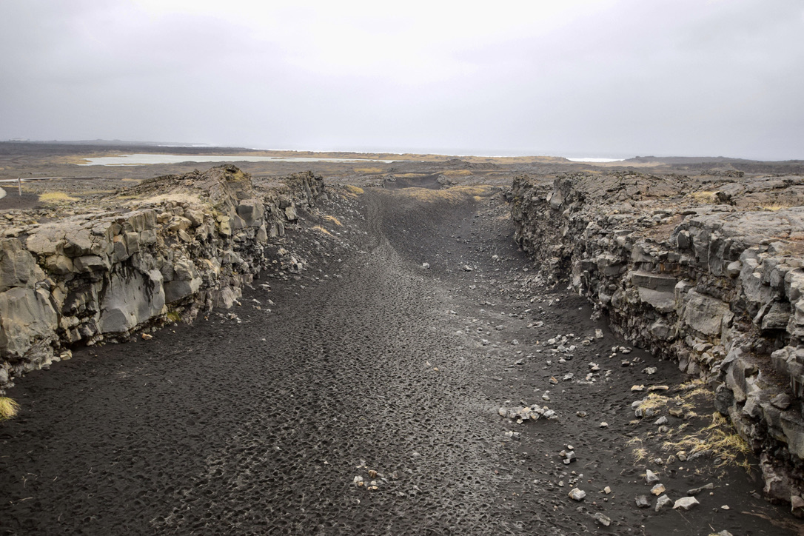
Geography:
Bridging the Gap
2025 Transition Work

Slide 2
2
Well done, you made a great choice. Of course, as geography graduates (yes, we all studied geography at Uni) so would say that wouldn’t we!
Well, don’t just take our word for it. According to the former president of the Royal Geographical Society, Michael Palin, “Geography is not only up-to-date and relevant, it is one of the most exciting, adventurous and valuable subjects to study today. So many of the world's current problems boil down to geography and need the geographers of the future to help us understand them.”
Former US President, Barack Obama, recognises the importance of geography too! He said "The study of geography is about more than just memorizing places on a map. It's about understanding the complexity of our world, appreciating the diversity of cultures that exists across continents. And in the end, it's about using all that knowledge to help bridge divides and bring people together."
In our rapidly changing world, we need people like you to study geography more than ever. The adopted godfather of geography, David Attenborough agrees! He said “The truth is: the natural world is changing. And we are totally dependent on that world. It provides our food, water and air. It is the most precious thing we have, and we need to defend it.”
An essential outcome of studying geography is being able to apply knowledge and understanding to new settings. Thinking like a geographer is an amazing ability as Dr Rita Gardner points out “Geography prepares young people with the knowledge, skills and understanding to make sense of their world and to face the challenges that will shape our societies and environments at the local, national and global scales.”
With the skills and knowledge of a geographer you can make a difference to the world we live in. Welcome to team geography.
“One of the most exciting, adventurous and valuable subjects today”
“Helps bridge divides and brings people together”
“Geography prepares young people with the knowledge, skills and understanding to make sense of their world”
“(The world) is the most precious thing we have, and we need to defend it”

Slide 3
Exam Board: AQA Spec: 7037
Prior knowledge Water & Carbon YR12
Students will benefit from being aware of the following before they commence their studies:
• Water is continuously being recycled between the land, atmosphere, rivers, lakes, oceans and living things in a process called the water cycle.
• Carbon emissions are linked to the burning of fossil fuels – these are non-renewable energy resources.
• The amount of carbon dioxide in the atmosphere is increasing, and this is leading to global warming.
Prior knowledge Urban YR12
Students will benefit from being aware of the following before they commence their studies:
• the process of urbanisation and how it varies throughout the world and over time
• the expansion of the world’s urban population, the greatest increases being in less developed
economies
• the difference between the causes and pace of urban change in more and less developed economies
• the different functions within a settlement
• the concept of sustainability.
Prior knowledge Changing Places YR12
Students will benefit from being aware of the following before they commence their studies:
• that places have always been important to people
• that different places are perceived differently by people and this affects their behaviour within them
• that perceptions of place can be changed and manipulated, with both positive and negative
consequences.
Prior knowledge Glacial YR13
Students will benefit from being aware of the following before they commence their studies:
• The main features of glaciers, such as their inputs, outputs, processes and stores.
• The scale and types of ice masses, such as ice caps, sheets and valley glaciers, as this knowledge would be helpful in developing an understanding of their mass and the significant role they can have in changing landscapes.
• The location of the world’s cold environments, both polar and alpine.
• The characteristics of an Ice Age and the processes of erosion and deposition.
Students may also have an understanding of weathering processes, such as freeze-thaw. This is covered in AQA’s new optional GCSE Chapter ‘Cold environments’ in Paper 1: Living with the Physical Environment.
Prior knowledge Hazards YR13
Students will benefit from being aware of the following before they commence their studies:
• the global distribution of tectonic hazards and tropical storms
• the physical processes occurring at each of the three types of plate boundary (constructive,
destructive and conservative)
• the physical conditions required for tropical storms to occur
• the reasons why people live in areas susceptible to hazards
• how monitoring, protection, prediction and planning can reduce the risks from hazards
• contrasting case studies that describe the hazard and the impacts, and how people have responded to the hazard in locations with different characteristics.
Prior knowledge Global Governance YR13
Students will benefit from being aware of the following before they commence their studies.
• Globalisation is a powerful process that has economic, social, environmental and political impacts.
• Globalisation has aspects that need to be managed.
• Globalisation provokes different views on the need to manage its impact.

Slide 4
3
As a further education (FE) student you’re going to find studying a little different to what you experienced at GCSE level. You are going to be expected to take more responsibility for your learning! This booklet will help you to develop skills that can be used across geography and other FE courses
In this booklet you are going to research Water and Carbon, Changing Places and Contemporary Urban Environments, your first three units that you will study in Year 12. This will give you some insights into the topics you will be studying, as well as some ways to organise your lesson and revision notes.
You will work through the next few pages, using the PPT to help you and complete the different tasks on organising and condensing your notes, finding connections, revision and testing yourself through application to questions
The tasks are:
Challenge 1 Cornell Notes. Watch the video and make notes on how to use Cornell Notes
Challenge 2: Take note. Read the 3 unit texts provided and summarise using Cornell notes
Challenge 3: Mind Mapping. Test yourself and shorten your notes whilst making connections by creating mind maps
Challenge 4: Compare and Contrast. Try summarising the notes using Venn diagrams
Challenge 5: Revise it. Make revision cards and use them to test yourself
Challenge 6: Assess it. Test your knowledge by answering the retrieval questions
The first two units have video links too:
Water & Carbon Cycles:
The link to the water and carbon videos can be found here and on the PPT: Understanding The Water Cycle and Carbon Cycle and
Changing Places:
The link below can be used or the link on the PPT
https://timeforgeography.co.uk/videos-list/human-geography-research/changing-places-how-do-we-study-place/

Slide 5
4
When studying at FE you will be expected to do wider reading. This means reading extra articles/books etc. in addition to your text books that link to your courses. Making organised notes when doing this can really help develop your knowledge and understanding. One really useful note taking technique is Cornell Notes.
You are going to use the Cornell Notes method of recording information from the water and carbon notes on the website link or notes on the next few pages. To do this, you are going to research how to use Cornell Notes using the resources below.
Cornell Notes
1. Watch the two videos about taking Cornell Notes on Internet Geography and/or the PPT: www.internetgeography.net/cornell-notes
Use the link above or scan the QR code
2. Divide up the page on the right to prepare it for recording Cornell Notes.
3. Annotate the page on the right to show how Cornell Notes should be completed.
4. Turn over the page and look at the example Cornell Notes that have been started. Using the webpage below complete the notes (I got up to paragraph 3 so start from 4).
www.alevelgeography.com/structure-of-the-earth
Use the link above or scan the QR code

Slide 6
5
An example:
Structure of the Earth
Keywords
Crust – oceanic > around 5km - continental > average around 30km (up to 100km large mountain ranges)
Continental crust
Mohorovicic Discontinuity (Moho)
Asthenosphere
Lithosphere
inner core
outer core
mantle
crust
Moho – boundary between the crust and mantle
Mantle – dense (due to temp and pressure) – semi- solid rock – 2900km thick
- iron / magnesium / calcium
Upper Mantle – Asthenosphere Lithosphere
100 to 300 km down
Semi molten (flows slowly)
Rigid layer between crust and asthenosphere
Questions
What are the characteristics of the Moho?
Summary

Slide 7
Add your own summary notes on how to lay out Cornell notes here:
7

Slide 8
6
Read the following 3 articles and complete Cornell Notes for each. Pages have been provided in this booklet for you to complete the activity.

Slide 9
6
Read the articles and complete Cornell Notes for each article. Pages have been provided in this booklet for you to complete the activity. Video links are on the PPT
The Water Cycle
Global Distribution and Major Stores of Water
Water is distributed across the Earth in various forms:
Lithosphere Water in the ground and rocks.
Hydrosphere Water in oceans, rivers, and lakes.
Cryosphere Water in ice caps and glaciers.
Atmosphere Water vapour in the air.
Processes Driving Change
Several key processes drive changes in the water stores, and these can be localised or global patterns.
Evaporation: Water transforms from liquid to vapour and enters the atmosphere.
Condensation: Water vapour cools and forms clouds.
Cloud Formation and Precipitation: Water falls from clouds as rain, snow, etc.
Cryospheric Processes: Involve ice, such as melting and freezing.
You may have heard about things like melting ice caps in geography before. This is one of the processes that can potentially drive change to the way water systems work.
Understanding Drainage Basins as Open Systems
A drainage basin collects precipitation and channels it to rivers and lakes. It functions as an open system with inputs, outputs, stores, and flows:
Inputs - Precipitation
Outputs - Evapotranspiration and runoff
Stores - Include interception by vegetation, surface water, soil water, groundwater, and channel storage
Flows - Stemflow (water running down plant stems), infiltration (water soaking into the ground), overland flow, and channel flow
The water balance in a drainage basin is the difference between inputs and outputs, determining the availability of water in the system.
Runoff Variation and the Flood Hydrographs
Runoff varies due to natural and human factors. A flood or storm hydrograph illustrates how a river's discharge changes over time following rainfall. Various factors like peak discharge and lag time can help in understanding flood risks and management.
Watch video on PPT link

Slide 10
6
Changes in the Water Cycle
The water cycle experiences changes due to natural variations, such as storm events and seasonal changes, as well as human impacts like farming practices and the way industry impacts water. These changes can significantly alter the availability and distribution of water and can cause droughts in certain areas.
The Carbon Cycle
Global Distribution and Major Stores of Carbon
Carbon is stored in various forms across the Earth:
Lithosphere: In rocks and fossil fuels.
Hydrosphere: Dissolved in oceans.
Cryosphere: Frozen in ice.
Biosphere: In living organisms including humans, animals, and plants.
Atmosphere: As carbon dioxide (CO₂) and methane (CH₄).
Factors Driving Change
Several processes affect carbon stores and their distribution:
Photosynthesis: Plants absorb carbon dioxide and are constantly playing a role in the storage of carbon.
Respiration: Plants and animals release CO₂.
Decomposition: Breakdown of organic matter releases CO₂.
Combustion: Burning fossil fuels and biomass releases CO₂.
Carbon Sequestration: Carbon is stored in oceans and sediments.
Weathering: Breakdown of rocks such as cliffs adds carbon to the atmosphere.
These processes operate at different scales, from individual plants to entire continents.
Changes in the Carbon Cycle
The carbon cycle changes due to natural variations, such as wildfires and volcanic activity, and human impacts, including hydrocarbon fuel extraction and burning, farming practices, deforestation, and land use changes. These changes can significantly impact carbon levels in the atmosphere and affect global climate patterns.
The Carbon Budget
The carbon budget is the balance of carbon inputs and outputs within the carbon cycle. Changes in this budget affect the whole world, influencing global climate and ecosystem health.
Watch video on PPT link

Slide 11
6
Water, Carbon, Climate, and Life on Earth
So, how does this all relate to life on earth?
The water and carbon cycles are fundamental to supporting life. Water is essential for all living organisms, while carbon is a key element in biological processes. These cycles interact and influence climate patterns, and can be affected by humans and animals.
Growth is closely linked to the water and carbon cycles. Image by Nik
Feedback Mechanisms
Feedback mechanisms within and between the water and carbon cycles can impact climate change. For example, increased CO₂ levels can enhance the greenhouse effect, leading to global warming and altered precipitation patterns. Understanding these feedbacks is crucial for predicting and managing climate impacts.
Human Interventions
Efforts to mitigate climate change include managing carbon transfers through practices like afforestation, carbon capture and storage (CCS), and promoting sustainable land use and energy practices. In the modern age, carbon and the environment are finally being considered.
Example: Tropical Rainforest
A case study of a tropical rainforest, such as the Amazon, illustrates the dynamics of water and carbon cycles. Watch video on PPT link
Rainforests have high biodiversity and play a significant role in global carbon sequestration. They are an example of a working cycle.
Trees and plants absorb water through their roots and release it into the atmosphere via transpiration. This moisture, along with evaporation from surfaces, forms clouds, leading to further rain, and the continuous movement of water maintains the rainforest's humidity and supports diverse plant and animal life.
In the carbon cycle, rainforests act as significant carbon sinks. Through photosynthesis, trees and plants absorb carbon dioxide (CO₂) from the atmosphere and convert it into organic matter, storing carbon in their biomass. When plants and trees die, decomposition releases some carbon back into the atmosphere as CO₂, while some carbon remains stored in the soil.
It is important to note that rainforests influence global carbon levels; deforestation and land-use changes release stored carbon, increasing atmospheric CO₂ and contributing to climate change.

Slide 12
7

Slide 13
8

Slide 14
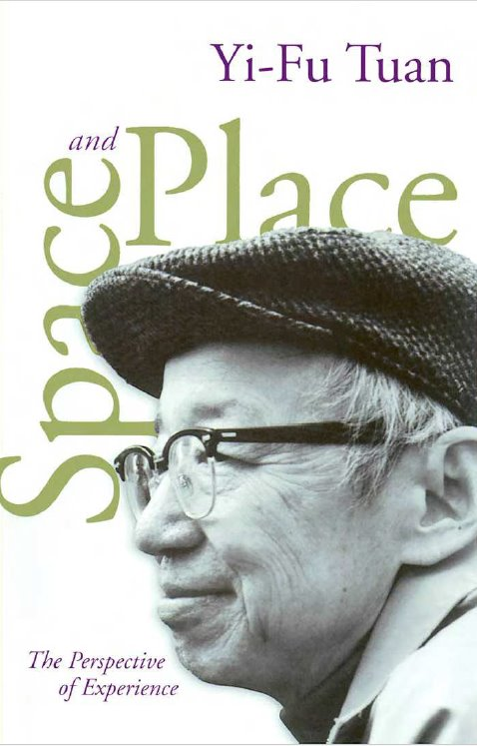
6
Changing Places
Space and Place The Perspective of Experience
The author of this book is widely considered to the most important geographer behind the origin of critical and humanistic (human) geography. He explores the way in which people feel and think about space, how they form attachments to home, neighbourhood, and nation, and how feelings about space and place are affected by the sense of time. A variety of modes can influence people and he examines non-fiction, poetry, psychology, and theology. ​
​
This is an excellent read of the Changing Places topic we will study for A-Level Geography. ​
Watch video on PPT link

Slide 15
6
"Space"and "place" are familiar words denoting common experiences. We live in space. There is no space for another building on the lot. The Great Plains look spacious. Place is security, space is freedom: we are attached to the one and long for the other. There is no place like home. What is home? It is the old homestead, the old neighborhood, home town,or motherland. Geographers study places. Planners would like to evoke "a sense of place." These are unexceptional ways of speaking. Space and place are basic components of the lived world; we take them for granted. When we think about hem, however, they may assume unexpected meanings and raise questions we have not thought to ask.
What is space? Let an episode in the life of the theologian Paul Tillich focus the question so that it bears on the meaning of space in experience. Tillich was born and brought up in a small town in eastern Germany before the turn of the century. The town was medieval in character. Surrounded by a wall and administered from a medieval town hall, it gave the impression of a small, protected, and self-contained world. To an imaginative child it felt narrow and restrictive. Every year, however young Tillich was able to escape with his family to the Baltic Sea. The flight to the limitless horizon and unrestricted space of the seashore was a great event. Much later Tillich chose a place on the Atlantic Ocean for his days of retirement, a decision that undoubtedly owed much to those early experiences. As a boy Tillich was also able to escape from the narrowness of small-town life by making trips to Berlin. Visits to the big city curiously reminded him of the sea. Berlin, too, gave Tillich a feeling of openness, infinity, unrestricted space. Experiences of this kind make us ponder anew the meaning of a word like "space" or "spaciousness" that we think we know well.
What is a place? What gives a place its identity, its aura? These questions occurred to the physicists Niels Bohr and Werner Heisenberg when they visited Kronberg Castle in
Denmark. Bohr said to Heisenberg:
Isn't it strange how this castle changes as soon as one imagines that Hamlet lived here? As scientists we believe that a castle consists only of stones, and admire the way the architect put them together. The stones, the green roof with its patina, the wood carvings in the
church, constitute the whole castle. None of this should be changed by the fact that Hamlet lived here, and yet it is changed completely. Suddenly the walls and the ramparts speak a quite different language. The courtyard becomes an entire world, a dark corner reminds us of
the darkness in the human soul, we hear Hamlet's "To be or not to be." Yet all we really know about Hamlet is that his name appears in a thirteenth-century chronicle. No one can prove that he really lived, let alone that he lived here. But everyone knows the questions Shakespeare had him ask, the human depth he was made to reveal, and so he, too, had to be found a place on earth, here in Kronberg. And once we know that, Kronberg becomes quite a different castle for us.

Slide 16
6
Recent ethological studies show that nonhuman animals also have a sense of territory and of place. Spaces are marked off and defended against intruders. Places are centers of felt value
where biological needs, such as those for food, water, rest, and procreation, are satisfied. Humans share with other animals certain behavioral patterns, but as the reflections of Tillich
and Bohr indicate, people also respond to space and place in complicated ways that are inconceivable in the animal world. How can the Baltic Sea and Berlin both evoke a sense of openness and infinitude? How can a mere legend haunt Kronberg Castle and impart a mood that infiltrates the minds of two famous scientists? If our concern with the nature and quality of
the human environment is serious, these are surely basic questions. Yet they have seldom been raised. Instead we study animals such as rats and wolves and say that human behavior and values are much like theirs. Or we measure and map space and place, and acquire spatial laws and resource inventories for our efforts. These are important approaches, but they need to be complemented by experiential data that we can collect and interpret in measured confidence because we are human ourselves. We have privileged access to states of mind, thoughts and feelings. We have an insider's view of human facts, a claim we cannot make with regard to other kinds of facts.
People sometimes behave like cornered and wary animals. On occasion they may also act like cool scientists dedicated to the task of formulating laws and mapping resources. Neither posture holds sway for long. People are complex beings. The human endowment includes sensory organs similar to those of other primates, but it is capped by an exceptionally refined capacity for symbolization. How the human person, who is animal, fantasist, and computer combined, experiences and understands the world is the central theme of this book.
Given the human endowment, in what ways do people attach meaning to and organize space and place? When this question is asked, the social scientist is tempted to rush to culture as an
explanatory factor. Culture is uniquely developed in human beings. It strongly influences human behavior and values. The Eskimos' sense of space and place is very different from that of Americans. This approach is valid, but it overlooks the problem of shared traits that transcend cultural particularities and may therefore reflect the general human condition. When note is taken of "universals," the behavioral scientist is likely to turn to the analogue of primate behavior. In this book our animal heritage is assumed. The importance of culture is taken for granted; culture is inescapable, and it is explored in every chapter. But the purpose of the essay is not to produce a handbook of how cultures affect human attitudes to space and place. The essay is, rather, a prologue to culture in its countless variety; it focuses on general questions of human dispositions, capacities, and needs, and on how culture emphasizes or distorts them. Three themes weave through the essay. They are:

Slide 17
6
(1) The biological facts. Human infants have only very crude notions of space and place. In time they acquire sophistication. What are the stages of learning? The human body lies prone, or it is upright. Upright it has top and bottom, front and back, right and left. How are these bodily postures, divisions, and values extrapolated onto circumambient space?
(2) The relations of space and place. In experience, the meaning of space often merges with that of place. "Space" is more abstract than "place." What begins as undifferentiated space becomes place as we get to know it better and endow it with value. Architects talk about the spatial qualities of place; they can equally well speak of the locational (place) qualities of space. The ideas "space" and "place" require each other for definition. From the security and stability of place we are aware of the openness, freedom, and threat of space, and vice versa. Furthermore, if we think of space as that which allows movement, then place is pause; each pause in movement makes it possible for location to be transformed into place.
(3) The range of experience or knowledge. Experience can be direct and intimate, or it can be indirect and conceptual, mediated by symbols. We know our home intimately; we can only know about our country if it is very large. A longtime resident of Minneapolis knows the city, a cabdriver learns to
find his way in it, a geographer studies Minneapolis and knows the city conceptually. These are three kinds of experiencing. One person may know a place intimately as well as conceptually. He can articulate ideas but he has difficulty expressing what he knows through his senses of touch, taste, smell, hearing, and even vision.

Slide 18
9

Slide 19
10

Slide 20
6
Contemporary Urban Environments
Future Cities Advisory Outlook 2024 Digital Urban Governance
Copyright © United Nations Human Settlements Programme (UN-Habitat), 2024
Major challenges of sustainable urban development Cities have become an important spatial base of human civilization with continuous economic and social development. Cities account for only 3% of the planet’s land area, but 56% of the world’s population is concentrated in cities and more than 80% of global GDP is generated by cities.
In recent years, the global urbanisation process has accelerated, especially in developing countries. According to United Nations (UN)- Habitat statistics in 2023, the population is rapidly concentrating in many developing countries. Some cities in African and Asian countries are experiencing average annual growth rates above 5% and are expected to maintain these high growth rates in the near future.
“Better City, Better Life” is a beautiful aspiration of human society. People continue to concentrate in cities for a better life, but this rapid concentration has led to a series of economic, social, and environmental “urban diseases,” such as poverty, traffic congestion, and environmental pollution. How to deal with these urban diseases and achieve sustainable urban development have become growing concerns in human society.
To bring greater global attention to sustainable urban development, the UN has taken a series of steps. In December 2013, the 68th Session of the UN General Assembly decided to designate October 31 of each year as World Cities Day starting in 2014. Moreover, at the UN Summit on Sustainable Development in 2015, UN member countries adopted The 2030 Agenda for Sustainable Development and the 17 Sustainable Development Goals (SDGs), specifically setting SDG 11 for cities. SDG 11 aims to create “inclusive, safe, resilient and sustainable cities and human settlements” and consists of 10 targets:
Safe and affordable housing
Affordable and sustainable transport systems
Inclusive and sustainable urbanisation;
Protect the world’s cultural and natural heritage
Reduce the adverse effects of natural disasters
Reduce the environmental impact of cities
Provide access to safe and inclusive green and public spaces
Strong national and regional development planning
Implement policies for inclusion, resource efficiency, and disaster risk reduction
Support least developed countries in sustainable and resilient building.

Slide 21
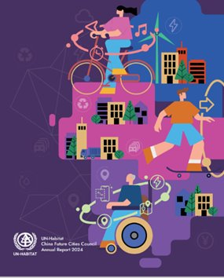
6
The UN Sustainable Development Goals Report 2024 identifies four of the most serious challenges to SDG 11:
The global slum crisis is worsening: 24.8% of the world’s urban population still lives in informal settlements (slums) without access to safe housing and basic public services.
Air quality has improved, but not enough to protect health; on average, 4.2 million people have died from urban air pollution.
Access to public transportation still needs to be improved; only 60% of the world’s urban population has access to convenient public transportation.
Urban resilience is urgent; the total number of disasters has increased fivefold over the past 50 years, and the average number of people affected by disasters has risen to more than 130 million per year over the past decade.
Urban governance is crucial for sustainable urban development. As suggested by UN Habitat’s World Cities Report 2022, “Whether and how economic opportunities; supportive social networks; and access to land, infrastructure and services are accessible to the urban poor is largely dependent on the efficacy of urban governance and institutional arrangements.
Urban governance remains central to effective crisis response and sustainable urban development”. In the context of the serious challenges posed by sustainable urban development, there is an urgent need for human society to seek innovative modes of urban governance to improve the living, productive, and ecological environments of cities. To this end, the rapid development of digital technologies offers possible new approaches.

Slide 22
11

Slide 23
12

Slide 24
13
You should now be in the position of having several pages of notes covering each of the three units of work. The challenge now is transforming the information you have gathered into knowledge. This is where mind maps can help! A mind map can help organise information and help illustrate how things are interrelated. The guide below illustrates how to create a mind map.
Step 1 Start with a central concept. Write this in the middle of a piece of plain paper that is orientated landscape.
Step 2 Draw a reasonably sized (coloured) memorable image that represents the topic you are going to be mapping.
Step 3 Draw branches from the central theme. Using a different colour for each branch is useful. Write key words along these branches that represent what information will be included on this branch.
What? When? Where? Why?
What?
Step 4 Draw additional branches that extend from your main branches. Add appropriate images where you can. Keep expanding the mind map.
When?
What? When? Where? Why?
Where?
Why?
Mind Mapping Rules
Use symbols
Keywords on lines
Lines of different colour, size, styles
Upper and lower case to emphasise
Vary colours
Key headings
lists
Organise your information and produce a mind map to show the main features of unit you will study

Slide 25
13
Blank Page for your mind map: Water & Carbon

Slide 26
13
Blank Page for your mind map: Changing Places

Slide 27
13
Blank Page for your mind map: Contemporary Urban Environments

Slide 28
14
Being able to compare and contrast is a useful skill to have when studying at a higher level. A useful tool to do this is a Venn Diagram. Venn Diagrams show the relations between multiple sets of information. The guide below illustrates how to use a Venn Diagram to compare and contrast two things.
Creating a Venn Diagram
Draw two circles that overlap (as shown below)
Identify the things you are comparing and contrasting
In the area below item one, identify everything that only applies to item one
In the area below item two, identify everything that only applies to item two.
In the area where the circles cross over, identify everything the two items have in common
Item 1
Item 2
Unique to item 1
Common features
of item 1 and 2
Unique to item 2
Create a Venn Diagram to compare and contrast two parts of what you have been studying. For example, where do water and carbon have similarities and differences? Can you categorise examples of Place and Space? What are the SEEP components of sustainable cities?

Slide 29
14
Water
Carbon
Water & Carbon
Changing Places
Space
Place

Slide 30
14
Contemporary Urban Env.
Social
Economic
Environmental
Political

Slide 31
15
In preparation for completing some questions based on your learning, you are going to spend some time revising the new content.
To do this, you are going to try a different approach to revision called the Leitner Box. The Leitner Box was developed by a German scientist called Sebastian Leitner and is a really effective, easy to develop practice and recall system. The approach involves using flash cards to learn and recall information. To begin with, you will need to develop a bank of flash cards covering the main aspects of the content. Follow the guide below to create your flash cards. Flashcards should be used to test your knowledge, not just as a way to condense your notes further.
1.
2.
Ensure that the flashcards have a question or key term on one side and the answer or definition on the other.
- The flashcard must work the memory.
- If flashcards only contain notes then no retrieval practice will be happening.
Ensure the right questions and knowledge are on the cards.
3.
Keep the information as short as possible. You are condensing the information you have.
4.
Write clearly. You should be able to read what you wrote at a very quick glance.
Leitner recommends that when we have a large amount of information to learn on flash cards we tend to focus on those we already know and avoid the ones we find difficult. To avoid this, create four sections in your storage box (or what ever way you are storing your cards).
Box 1
Here you put the cards for frequent practice. This is the stuff that needs regular review because you’re not remembering it. Spend around 40% of your time on these. When you are confident and fully recall a card, move it to box 2.
Box 2
Around 30% of your time is spent here. These are cards that have only just moved out of box 1, or cards containing information that still trips you up. If you’re not remembering it, move it up to box 1 or down to box 3 if you’ve regularly recalling it.
Box 3
Spend around 20% of your time here. These are the cards you can almost always recall. You feel confident about the content, even though some might be complex. If you make any mistakes in recall, move the card up to box 2.
Box 4
You’ll start with only a few cards here. This is the material you feel is easy to recall. You always get it right, therefore you only spend 10% of your time checking the cards here. However, it is key that nothing ever leaves this box as you know it so well.
Test yourself with the information on your cards. Have a friend or family member check your ability to recall the information on the cards. Repeat until all cards are in box 4.

Slide 32
16
Completing practice questions can really help develop your knowledge as well as your ability to apply this to demonstrate understanding. Over the next couple of pages are a selection of A Level transition questions to have a go at.
Water & Carbon:
Why is the rainforest carbon cycle important for the environment?
________________________________________________________________________________________________________________________________________________________________________________________________________________________________________________________________________________________________
Give two examples of how carbon can be stored.
________________________________________________________________________________________________________________________________________________________________________________________________________________________________________________________________________________________________________________________________________________
3. How are water and carbon good examples of systems?
________________________________________________________________________________________________________________________________________________________________________________________________________________________________________________________________________________________________________________________________________________

Slide 33
16
Changing Places:
How might space and place be different? ​​
________________________________________________________________________________________________________________________________________________________________________________________________________________________________________________________________________________________________________________________________________________________________________________________________
How can people attach meanings to a place? ​​
________________________________________________________________________________________________________________________________________________________________________________________________________________________________________________________________________________________________________________________________________________________________________________________________
What three ways does the text mention that might affect how somebody interacts with a space and place? ​​
________________________________________________________________________________________________________________________________________________________________________________________________________________________________________________

Slide 34
16
Contemporary Urban Environments:
What are “urban diseases,” and why are they a barrier to a “Better City, Better Life” in human society?​
________________________________________________________________________________________________________________________________________________________________________________________________________________________________________________________________________________________________________________________________________________________________________________________________
2. What is UN Sustainable Development Goal No 11 and how does it create “inclusive, safe, resilient and sustainable cities and human settlements”
________________________________________________________________________________________________________________________________________________________________________________________________________________________________________________________________________________________________________________________________________________________________________________________________
3. What are the main challenges to SDG 11?
________________________________________________________________________________________________________________________________________________________________________________________________________________________________________________

Slide 35
Wider Reading Journal
To achieve the top grades in A Level Geography you need to demonstrate you can ‘think like a geographer’. This means demonstrating insight and flair and an awareness of the world beyond that presented by your core A Level textbook. You will regularly record details of additional reading and research. These will be useful to incorporate into examination responses to help the examiner appreciate that you are a truly exceptional geographer! Why not start by recording anything you read over the Summer that relates to one of the 3 units for Year 12.
Source: title/where did you get this information from? | Summary of information: Remember to be selective and include place names, facts and figures that you will incorporate into exam questions | What area of the specification does it link to? How are you going to use the information? Which type of questions may you be able to incorporate the knowledge you have gained?

