Slide 1
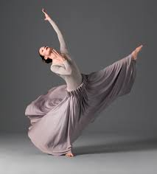
Btec Dance: Unit 1 & Unit 3
LO: Make appropriate interpretations of dance works which are supported by detailed examples.

Slide 2
Let’s think….
What do we mean by interpreting dance?
Do we all interpret dance in the same way?
Note down your ideas
Similar?
Individual?
Theme?
Choreographic intent?
Opinion?

Slide 3
The definition:
To interpret something means to…
“explain the meaning of
(information or actions).”
Note down the definition or add to your own

Slide 4
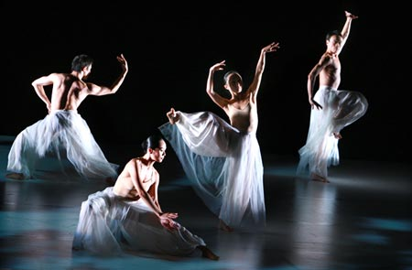
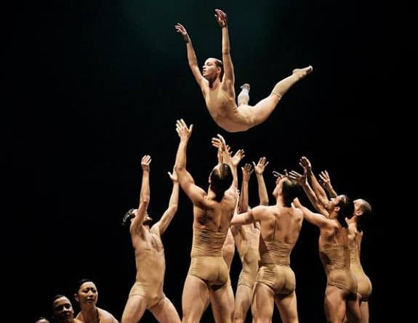
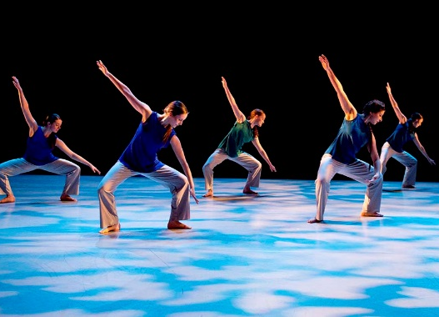
All interpretations are welcome as long as they are justified with a detailed reason why!

Slide 5
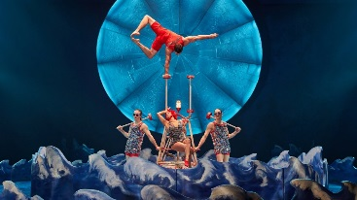
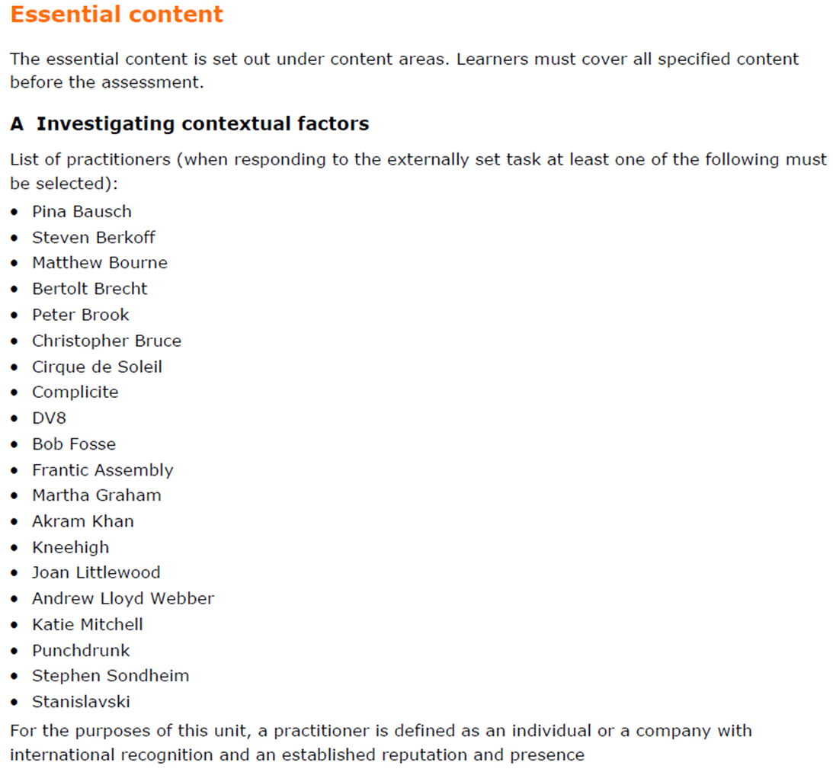
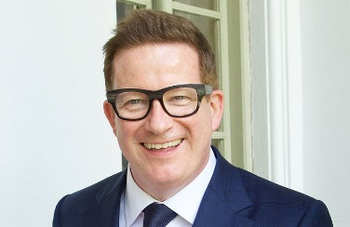
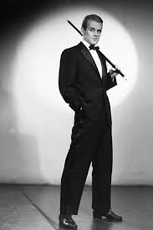
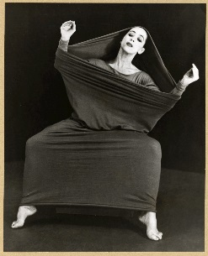
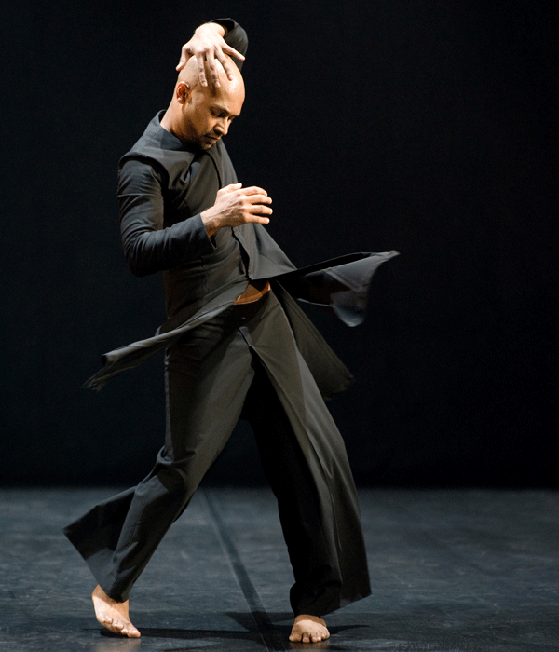
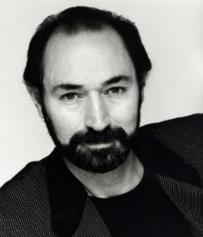
List of practitioners
Choose one work from 3 of the following practitioners that have been starred:
Cirque du Soleil
Pina Bausch
Matthew Bourne
Bob Fosse
Martha Graham
Akram Khan
Christopher Bruce

Slide 6
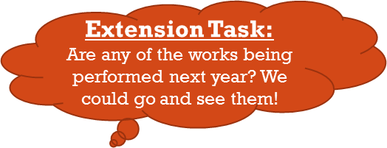
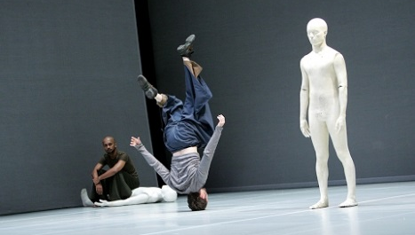
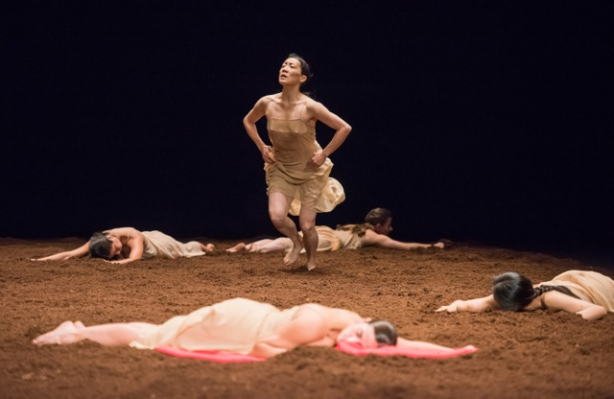
Task 1:
Find 3 practitioners’ works (from the previous list) that also have an interview or article as to why the choreographer made that work/ ideas behind the work/ influences.

Slide 7
Task 2:
Watch the 3 videos
Make as many interpretations of the video as you can
Give as many detailed examples of why you think this as possible
I think this dance was about….
I think this because the dancers did…

Slide 8
Task 3:
Watch the interviews/ read the articles about the work.
Make notes on the influences of the pieces (why was it made?): Analyse and make notes on the following:

