Slide 1
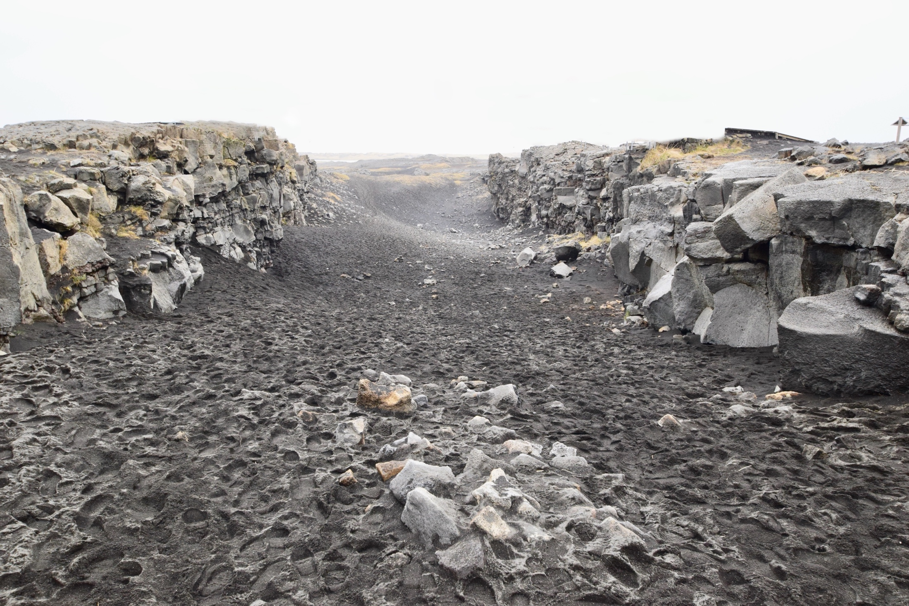
The leap between GCSE and FE can be huge.

Slide 2
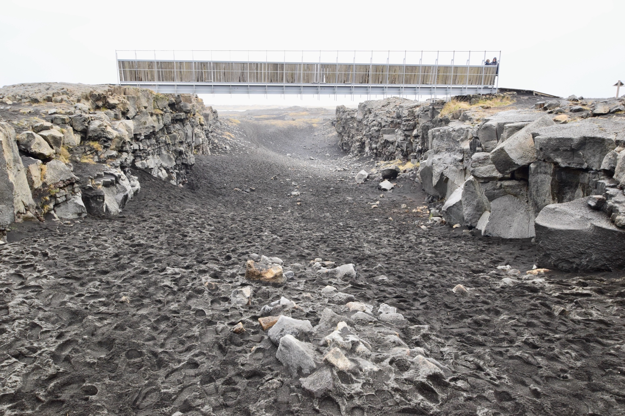
So, we’re doing a bridging unit to help prepare you.
Notes:
The image shows Leif the Lucky's Bridge between Europe and North America on Reykjanes Peninsula.

Slide 3
This study will help develop some important skills...

Slide 4
…to help prepare you for success in A Level Geography

Slide 5
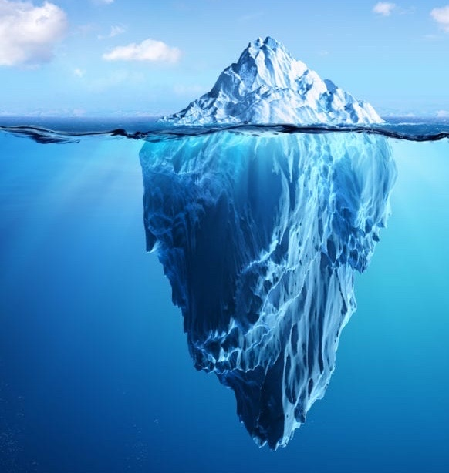
What we’ve explored so far.
What you’ll be exploring.
Notes:
The information shared so far is just the tip of the iceberg. At FE level you will be expected to complete independent research and go into greater depth than we did at GCSE level.

Slide 6
Cornell Notes
Organise the information
Notes:
IT is worth emphasising that when studying at FE level they will be required to read extended pieces. Cornell notes allows them to organise new information. Students to complete Cornell Notes using page on A Level Geography - www.alevelgeography.com/structure-of-the-earth

Slide 7
Cornell Notes
Organise the information
Notes:
Complete Cornell notes for the resource booklet

Slide 8
Water & Carbon Videos
The points to watch each are identified in the booklet and on the website link
Understanding The Water Cycle and Carbon Cycle

Slide 12
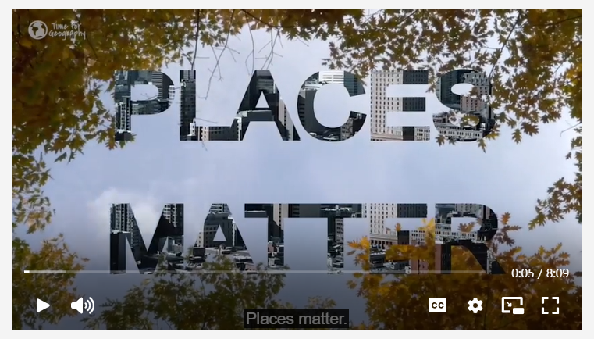
Changing Places Introduction
https://timeforgeography.co.uk/videos-list/human-geography-research/changing-places-how-do-we-study-place/

Slide 13
Mind Mapping
Turning information into knowledge
Notes:
Share the A3 templates and ask the students to use their notes (with occasional reference to the case study resources) to complete the mind maps.

Slide 14
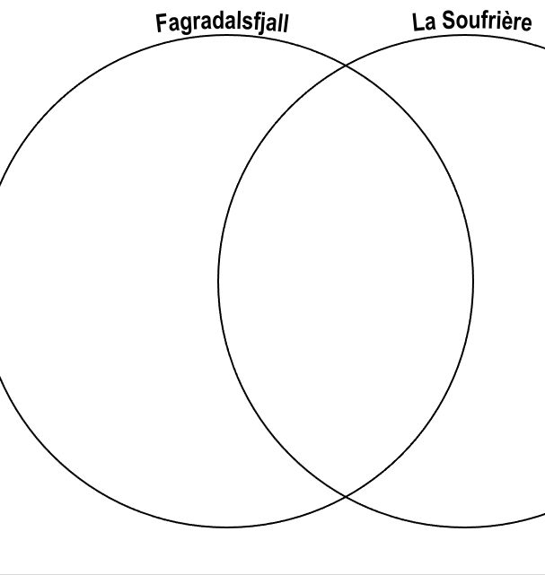
Venn Diagram
Compare and contrast
Notes:
Introduce Venn diagrams and their value in comparing and contrasting. The students are to use the A3 template to compare and contrast the two eruptions.

Slide 15
Revise It
front
Key word or question
Revision Cards
back
Definition or answer

Slide 16
Revise It
Box 1
Box 2
Revision Cards
Frequent practice
40% of time
Move to box 2 when you are confident you can recall the card
Regular practice
30% of time
Move to box 3 when you are confident you can recall the card
Box 3
Box 4
Limited practice
10% of time
Nothing leaves this box as you know it so well
Occasional practice
20% of time
Move to box 1 when you are confident you can recall the card

Slide 17
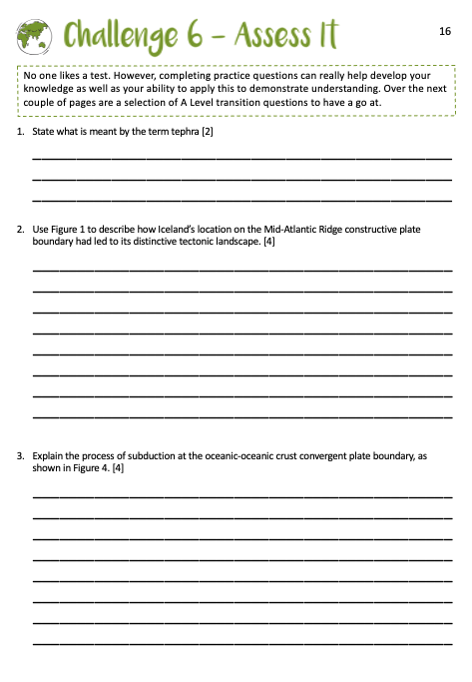
Assess It
Practice, practice, practice

